Slide 1
Oncology Reimbursement “Gambling on 2023”
Presented by:
Michelle Weiss, CHONC
President, Weiss Oncology Consulting

Slide 2
Disclaimer
The information in this presentation is not intended to provide reimbursement, legal or financial advice; it is for informational purposes only. Participants will need to do their own research and make their own decisions when seeking reimbursement.
Regulations and policies concerning payer reimbursement are a rapidly changing area of the law. While we have made every effort to be current as of the issue date, the information may not be current or comprehensive when you review it or may contain inaccuracies or typographical errors.
Please watch for announcements from CMS and private payers directly and be sure to consult with your legal counsel for any specific reimbursement information and advice.

Slide 3
CPT® is a Trademark of the American Medical Association
Current Procedural Terminology (CPT) is copyright American Medical Association
All Rights Reserved
No fee schedules, basic units, relative values, or related listings are included in CPT
The AMA assumes no liability for the data contained herein
Attendees can purchase AMA CPT or CPT Assistant by calling 800-621-8335 or online at www.ama-assn.org/cpt/online
2023 CPT Book released Mid-October

Slide 4
Getting Ready for 2023 REMINDERS
Financial Navigation
Everyone should be ALL IN!

Slide 5
Financial Navigation
So many patients are changing insurance NOW
Make sure to notify EVERYONE including any foundations or co-pay cards your patients may be enrolled in!
Open Enrollment –
Medicare = 10/15 – 12/7
Medicare Advantage (only) = 1/1 – 3/31
Reminder – Can offer additional benefits BUT must cover all of the medically necessary services that original Medicare covers
Reminder – Medicare Advantage Plans can’t charge more than original Medicare for certain services, like chemotherapy!
Medicare Advantage Disenrollment Period = 1/1 – 2/14
ACA Healthcare Marketplace – 11/1 – 1/15
Medicare And You 2023 – The Official U.S. Government Medicare Handbook

Slide 6
Financial Navigation
Complete Insurance Investigation
Prior Authorizations – URGENT
We will discuss legislation on this topic shortly
Addressing Patient Out of Pocket Expenses
Patients have a right to know what support is available
No time or lack of staff isn’t an allowable excuse anymore
– Hire a company to do it!
HARD STOP

Slide 7
Watch Out!
Copay Accumulators
a manufacturer’s co-pay assistance no longer applies to the patient’s annual deductible or out-of-pocket maximum
Copay Maximizers
increases the co-pay amount for the product to match the annual maximum benefit amount of the applicable co-pay program
Alternate Funding Requirements
Denies drug and requires use of manufacturer free drug program
Site of Care Restrictions
Cannot be treated in the hospital outpatient department

Slide 8
Financial Navigation
Patient’s Right To Know
Surprised Billing Legislation passed in 2021
Updated with Final Rule in August, 2022
Website: Cms.gov/nosurprises
Requires hospitals to:
Make publicly available standard prices for at lease 300 medical services
Provide prices negotiated with insurance companies and lowest prices for self pay
Provide clear, understandable information about what is included in the posted price

Slide 9
Financial Navigation
Patient’s Right to Know
No Surprises Act (within the Consolidated Appropriations Act, 2021)
Patients cannot be billed beyond in-network cost-sharing for emergency care
Helps patients access information about the costs of the care they will receive
If a patient relies on erroneous network directory information to choose a physician, the plan cannot impose a cost-sharing amount greater than in-network rates and it must count toward the patient’s in-network out-of-pocket maximum and in-network deductible
Unless notice and consent requirements are met in non-emergency situation, if a provider submits a bill in excess of in-network cost sharing and the patient pays, the provider must REFUND WITH INTEREST!
Effective January 1, 2022,out-of-network providers MUST provide a “good faith estimate” of all services at least 3 days prior to obtaining consent for treatment

Slide 10
Financial Navigation
No Surprises Act, cont.,
How does this help providers?
Clarification that upfront, initial payment or notice of denial is required from health plans to the physician within 30 days of when claim is filed
Seems like a long time BUT this might be a way to resolve issues with a payer not covering things they should!
This ACT requires a Independent Dispute Resolution Process
Process must begin within 3 days of request
Link to the AMA six-page guide summarizing the Law
Link to CMS overview of rules and fact sheets

Slide 11
Prior Authorization Legislation
Federal
Medicare Advantage Requirements
Establish Electronic Process
Reduce how long the payer has to respond
Included “real time” decisions
Requires plans to report on their prior authorization use and rate of approvals and denials

Slide 12
Prior Authorization Legislation
Commercial Insurance (State Level)
Prior Authorization Laws
Requires payers to turn around Emergent PA requests within 48 – 72 hours
Most all states are attempting to pass stricter legislation
Favorite – Texas “Gold Card” Law Passed June 2021
If a provider has PA requests for treatments and prescriptions approved by insurer at least 90% in the 6 month review period they achieve “GOLD CARD” status and are exempt form Pas
Additionally, the person reviewing the PA via peer-to-peer must be a Texas licensed physician OF THE SAME OR SIMILAR SPECIALTY!!

Slide 13
Prior Authorization Legislation
State Level
United Healthcare Texas
Effective 10/1/2022
UHC reviewing "least 5 prior authorization requests for a service submitted by you between Jan. 1, 2022, and June 30, 2022. If you have a 90% or greater final approval rate for those requests for a service, you are exempt from requesting prior authorizations for those services. You can receive exemptions for multiple services.

Slide 14
Get ready for Electronic REQUIREMENTS 2023 & Beyond
United Healthcare just announced;
Reconsiderations, appeals and claims moving to digital submissions ONLY in 2023
Will give 90 day notice
CLICK HERE to view the UHC Notice and instructions!

Slide 15
REMINDER
Know Your Payers!!
Staying on top of payer changes is more difficult than EVER!

Slide 16
Know Your Payers!!
Track issues by Payer
Both problems and what works well!
Track Contacts!
What value based projects are you doing that may help negotiate a better contract?
Can you get exceptions on Prior Auths?
Review website & alerts monthly
If they are in YOUR top 5, your not to small to request additional attention!

Slide 17
REMINDER Addressing Payer Issues
Don’t let them get away with not reimbursing for your patient’s care!!!

Slide 18
Addressing Payer Issues
Where you go for resolution depends on who they are!
Federal Programs including Medicare, Medicare Advantage, Medicaid & Managed Medicaid
Go through Government Process
We will review this in detail
**of note: Medicaid is also managed by individual States
Commercial Insurance (including marketplace plans)
Go through the State Department of insurance
Or say you are going to!!!
Employer Groups –
Go through the Department of Labor or Employee Human Resources Department
**Often look like commercial plans

Slide 19
REMINDER Know the Laws
AND USE THEM!!

Slide 20
Know the Laws
Did you know…Commercial Insurance (State Level)
***Most all states have them!!
Clean Claim Required to Pay or Deny in 30/45 days with interest
Pennsylvania – 45 days / 12% Interest
http://www.pacode.com/secure/data/031/chapter154/s154.18.html
New Jersey – 30 days / 10% Interest
http://www.state.nj.us/dobi/division_insurance/drcorner.htm
Reminder – If more information is requested by the payer
add’l 45/30 days

Slide 21
REMINDER Know When, Where and How to Push Up!
Medicare, Medicare Advantage and Medicaid
What works for me…

Slide 22
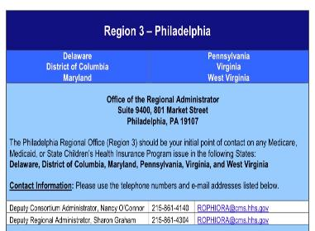
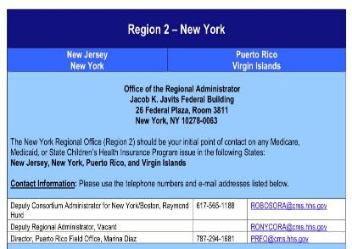
When, Where and How to Push Up
After attempts with the payer,
Use the CMS Regional Office BUT make sure you copy the payer on your complaint!!

Slide 23
When, Where and How to Push Up
If that doesn’t work or in combination with the Regional Office. utilize the SBA Ombudsman for Federal Program Issues – including the Department of Labor
Purpose:
Small business owners may use this form to submit comments on Federal enforcement/compliance actions that they consider excessive or unfair.
The National Ombudsman will use the information when it contacts the applicable Federal agency for a review of the action. Completion of this form is mandatory to request assistance from the Office of the National Ombudsman.
Choose the online “comment” complaint form:
https://www.sba.gov/about-sba/oversight-advocacy/office-national-ombudsman

Slide 24
SBA Ombudsman
Submit Form
You will immediately receive receipt
Within about 2 weeks you will receive acknowledgement w/case number assigned
IF you stated you had additional information to submit, you will receive an email allowing you to submit additional information
You will email any supportive information to substantiate your complaint/comment
They will contact the payer and work out the issue
Usually within about 30 – 45 days from time of additional data submission, you will receive a final determination by email and by snail mail
I have had 100% success rate with Medicare Advantage Plans
Medicaid plans continue to be a challenge because of State budgets – but some success
I recommend sending a copy of your complaint to the payer
They will often correct the problem as soon as they are aware they have been reported!

Slide 25
REMINDER Wrongful Denials
Never Give UP!
Fight for your patient,
your provider, and your peers!!

Slide 26
Wrongful Denials
New Codes/Net Drugs/New Indications
Expect an initial denial!
Upload the information with the claim!
Review the PWK Process with CMS!
Other Common Denials
Medically Unlikely Edits for Drugs
Weight based doses on a heavy patient will fall outside of the MUE allowed for the drug
KEEP YOUR 1st level appeal SIMPLE and to the point!
CMS MUST PAY THIS CLAIM!
Sadly – you will have to appeal each treatment
Link to the Practitioner Services MUE Table Download – scroll down to bottom of this page! List includes MANY drugs and services!

Slide 27
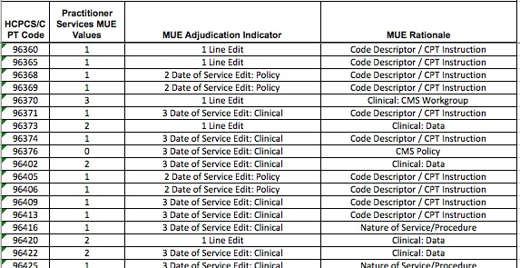
MUE Example – Admin Codes
Example of 1 initial code per day!

Slide 28
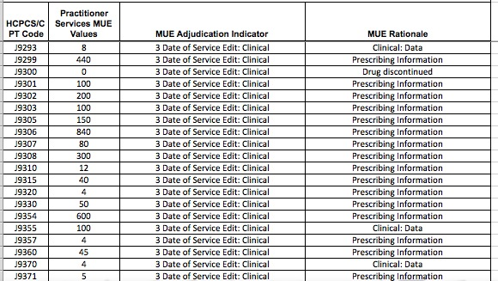
MUE Example – Drugs

Slide 29
Wrongful Denials
Prior Authorization Denials
Obtained but they say it isn’t
Obtained but now they deny for medical necessity
Not obtained because you were told you don’t need one
Not obtained because you were only allowed 3 and you forgot to reach back on the 4^{tth,} 5th, 6th treatment
FIGHT!

Slide 30
REMINDER Evaluation and Management Changes!
Change is difficult but – might be your best friend!

Slide 31
E & M Reminders
2022 - New Changes Applied to Office and Outpatient Visits ONLY
WATCH OUT – Keep an eye on hospital code choices and documentation!!
E & M coding guideline updates for inpatient care is to change in 2023!
We will review in a few minutes but…
How have you prepared you team?

Slide 32
REMINDER Please Don’t Forget About…PCM
Principle Care Management Codes
Don’t Miss Out – NEW CODES IN 2022
99424 & 99425 – Provider codes
99426 – 99427 – clinical staff
PCM highly utilized in Oncology
Phone calls, updating the care plan, portal messages, discussing the case with other providers, overseeing transitions of care
“10 hours a week of PCM services provided by a physician, NP, or PA could generate more than $5,000 per month in revenue
And you are probably already doing this but are not reimbursed for the work

Slide 33
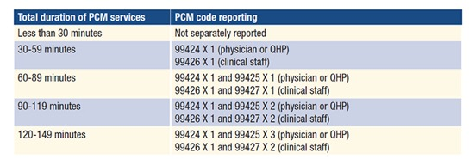
Principle Care Management
2022 PCM Codes:

Slide 34
REMINDER Advanced Care Planning
REMINDER - Advanced care planning including the explanation and discussion of advanced directives such as standard forms (with completion of such forms, when performed), by the physician or other qualified health care professional
CPT Code:
99497 – 30 minutes, face to face with the patient, family member(s) and/or surrogate
99498 – additional 30 minutes
Can be billed “incident-to”
Can be the same day as the office visit
Can be billed by physicians or NPPs
No limits on the number of times you can report ACP for a given patient in a given time period
Should have patient consent
CMS MLN: https://www.cms.gov/outreach-and-education/medicare-learning-network-mln/mlnproducts/downloads/advancecareplanning.pdf

Slide 35
Happy New Year! 2023!
So little time…
SO MUCH TO TELL…
And still so much unknown…

Slide 36
Public Health Emergency
Will it be over in 2023?
Are we preparing for AFTER?
CMS Released and Recently Updated CMS a ROADMAP for the eventual end of the Medicare PHE waivers and flexibilities, and is sharing information on what health care facilities and providers can do to prepare for future events. CLICK HERE

Slide 37
Public Health Emergency
PHE recently extended for another 90 days – January 11, 2023
Expect a 60 day notice before the PHE termination
Many provisions tied to the PHE
1135 Waiver allows modifications to Medicare and Medicaid
Dozens of waivers enacted including telehealth and payment for phone calls
Waivers of cost sharing for COVID
Flexibilities on Controlled Substances
Medicaid coverage
After PHE – Back to before unless Congress acts
Many waivers will expire 151 Days after the end of the PHE
On their own, CMS does not have authority to continue many of the provisions

Slide 38
2023 ICD-10
Effective October 1, 2022 - Good News!
Around 1,400 overall but for oncology, there weren’t many changes
Slight tweak to T-cell Lymphoma Code Descriptors
C84.4 – C84.49
Not classified (no code to describe condition)
to “not elsewhere classified” the clinician did not specify the type of lymphoma

Slide 39
2023 ICD-10
Effective October 1, 2022
“Z” Codes for Long-Term Use of Chemotherapy
Z79.63 (Long term [current] use of chemotherapeutic agent)
Z79.630 (Long term [current] use of alkylating agent)
Z79.631 (Long term [current] use of antimetabolite agent)
Z79.632 (Long term [current] use of antitumor antibiotic)
Z79.633 (Long term [current] use of topoisomerase inhibitor)
Z79.64 (Long term [current] use of myelosuppressive agent)
Z79.69 (Long term [current] use of other immunomodulators and immunosuppressants)

Slide 40
2023 ICD-10
Effective October 1, 2022
Unique Codes for Patient Noncompliance
Z91.190 (Patient's noncompliance with other medical treatment and regimen due to financial hardship)
Z91.198 (Patient's noncompliance with other medical treatment and regimen for other reason)
Z91.199 (Patient's noncompliance with other medical treatment and regimen due to unspecified reason)

Slide 41
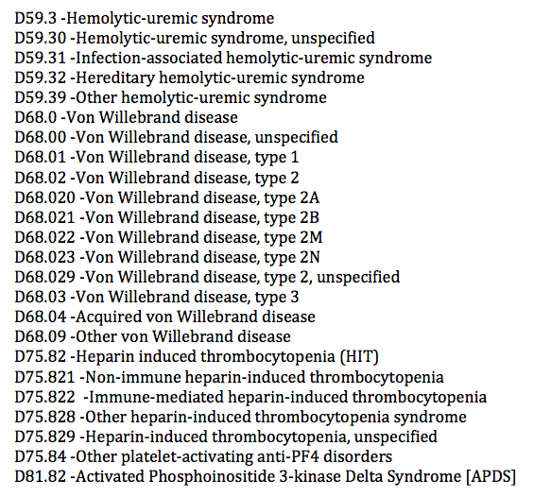
2023 ICD-10 Hematology

Slide 42
AMA CPT 2023
CPT Changes Effective 1/1/2023
Physician Services are billed using the AMA CPT Codes
Each CPT code has a value (RVU)
RVU x GPSI (geographic price cost indices)
Physician work RVU
Practice expense RVU
Associated malpractice RVU
Medicare payments are based on the Conversion Factor x the RVU
NOTE: Congress requires CMS to review the RVUs no less than every five years and develop RVUs for new services and “misvalued” codes identified by CMS. The Relative Value Scale Update Committee (RUC) is responsible to make RVU recommendations. CMS generally accepts the RUC recommendations.

Slide 43
2023 CPT Changes
Effective January 1, 2023
Includes many changes but not for oncology with exception of the multitude of changes in the evaluation and management coding section!
Overall 393 editorial changes, including 225 new codes, 75 deletions and 93 revisions!
Deletions in prolonged, observation, consultations and more!
Revised in hospital inpatient services (initial, subsequent, discharge for example now include “inpatient or observation care” along with office or other outpatient codes
Prolonged code 99417 is revised to specify that it is for outpatient E/M and not for office or other outpatient
No changes in the Administration Section
Reading through this sections each year is a great idea….
Only a few pages – Rules are fresh in your mind!

Slide 44
E & M Changes for 2023
Hospital
Split Shared Visit Changes – Delayed to 2024
Inpatient and Observation Combined
Prolonged Services – with differences between CMS and CPT
MDM vs Time
Consultation Codes
AMA Resources – E/M Revisions to Code Descriptors and Guidelines 2021 - 2023

Slide 45
E & M Changes 2023
Hospital
Like the office, code selection is based on medical decision making or time. History and exam and not used to select the code but,
they are still important components in establishing medical necessity, supporting medical decision making, and providing high-quality care.

Slide 46
E & M Changes 2023
Observation care services
Deletion of observation CPT codes
99217-99220, 99224-99226
merged into the existing hospital care CPT codes
99221, 99222, 99223, 99221-99233, 99238-99239

Slide 47
E & M Changes 2023
Inpatient AND Observation Services
Combined in 2023!
Use MDM or Time to choose level of service
Editorial revisions to the code descriptors to reflect the structure of total time on the date of the encounter or level of medical decision-making when selecting code level
Initial: 99221 – 99223
Subsequent: 99231 – 99233
Same Day: 99234 – 99236
Discharge: 99238 – 99239

Slide 48
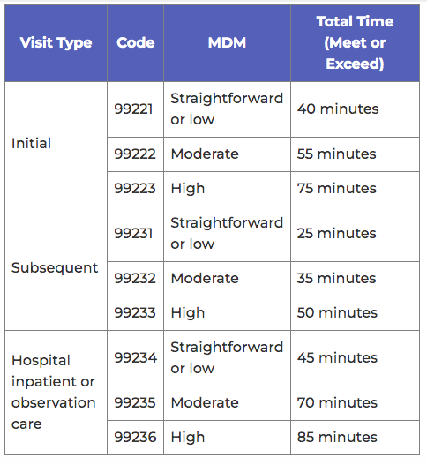
E & M Changes 2023
Time
Includes face-to-face and non-face-to-face activities
50% rule no longer applies
If service is continuous after midnight, all time must be attributed to only one date of service
Same Day Admit/Discharge

Slide 49
Changes to…
Initial
Prior to 2023
Report 1st hospital encounter by admitting physician
2023
Report when the patient has not received any professional services from physician/QHP of the exact same specialty and group during stay
Subsequent
Prior to 2023
Report after the date of initial admission
2023
Report when the patient HAS previously received any professional services from a physician/QHP of the exact same specialty and group during stay

Slide 50
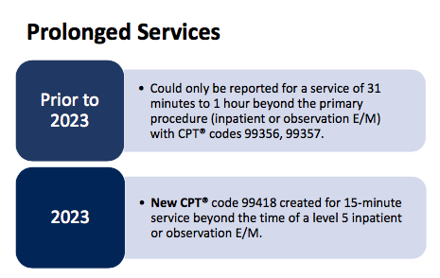
E & M Changes 2023
Prolonged
CPT =
Highest code, plus 15 min
CMS =
Highest code, plus 15, PLUS 15!!
Watch for new code:
GXXX1

Slide 51
E & M Changes 2023
CPT Prolonged Coding Example:
Initial Prolonged Initial & Prolonged
99223 99418
75 min + 15 min = 90 min
CMS Prolonged Coding Example
Initial Prolonged Initial & Prolonged
99223 99418
75 &15 min + 15 min = 105 min

Slide 52
E & M Changes 2023
Consultations
Retention of the consultation codes, with minor, editorial revision to the code descriptors
99242 – 99245 – Office
99252 – 99255 - Hospital
Deletion of confusing guidelines, including the definition of “transfer of care."
Deletion of lowest level office (99241) and inpatient (99251) consultation codes to align with four levels of MDM
Not recognized by Medicare and many private payers!

Slide 53
Outpatient Hospital and Physician Fee Schedule 2023 Rules
To be released around November 1st!
(Slides were due on October 31st!)

Slide 54
2023 CMS Final Rules
Physician Fee Schedule – Proposed in July
Includes 4.4% cut to the conversion factor
Split/Shared Visit changes delayed until 2024
Practice Expense and Malpractice RVUs revised
Misvalued Code Changes
Changes to the GPSI (location)
Manufacturer Rebates for Single Use Drugs
Adding a JZ modifier (or use waste JW)
And so much more…..

Slide 55
2023 CMS Final Rules
Physician Fee Schedule – Proposed in July
ASCO, COA, ACCC, and so many others ask….
Provide at least a 4.5% conversion factor adjustment for the PFS in 2023
Waive the 4% statutory PAYGO requirement
Provide a one-year inflationary update based on the Medicare Economic Index (MEI)
Eliminate the 2% sequestration cut to Part B

Slide 56
2023 CMS Final Rules
Hospital Outpatient Prospective Payment System (HOPPS)
Some of the changes include;
2.7% payment rate increase
340B reimbursement rate of ASP – 22.5%
Even though the Supreme Court ruled ASP +6%
Expanded Prior Authorization requirements – none in oncology

Slide 57
Are We Going to Be OK?

Slide 58
Concerns…. ALERT YOUR SOCIETY
Don’t assume they are aware of the issue!
Stay Informed!

Slide 59
Questions?
Michelle Weiss, CHONC
Email: Michelle@weissconsulting.org

