Slide 1
Title Layout
PHOMS Fall Conference
Update on Everything Oncology in D.C. and Beyond
Ted Okon
Executive Director
November 3, 2022

Slide 2
What’s Happening in D.C. in General?
Title, Text Layout
Congress recently passed a short-term spending bill to avert a government shutdown till after the elections
But a fight looming after the elections
All eyes now on the elections next week
Democrats pointing to wins on inflation reduction and lowering drug prices and focusing on the Supreme Court and red state abortion rulings
Republicans pointing to record inflation, immigration, and general lawlessness
Congressional Republicans looking forward to taking the majority in the House and possibly in the Senate
Democrats were more optimistic about possibly keeping the House and feeling good about the Senate, but that is waning
Senator Manchin gave his party a big win in passing the Inflation Reduction Act
But overplayed his hand and came up dry in passing some energy transfer measures for WV
Ironic that both progressive Democrats and Republicans lined up against Manchin

Slide 3
What’s Happening in D.C. Oncology Related?
Title, Text Layout
Inflation Reduction Act (IRA) empowers Medicare to negotiate drug prices
Pressure ramping up on hospitals, especially with 340B
Hospitals marking up cancer & other expensive drugs
COA released an updated study on 340B hospital drug mark-ups (5X)
Studies also report on over-charges on services
Pharma company restrictions on the use of multiple contract pharmacies in the courts
FTC looking at the impact of hospital consolidation on patient care (and increasing costs)
Increased media coverage on high hospital costs and 340B bad behaviors
But with all this, CMS is proposes to increase drug reimbursement to 340B hospitals
State and Federal pressure ramping up on PBM bad behaviors
Democrats have stepped out on admitting PBMs have a hand in fueling drug prices higher
State pressure, and legislation, continue to mount
Enhancing Oncology Model (EOM) announced as the follow-up to the Oncology Care Model (OCM)
COA received an extension for applications till 10/10
Encouraged practices to apply even if unsure about participating

Slide 4
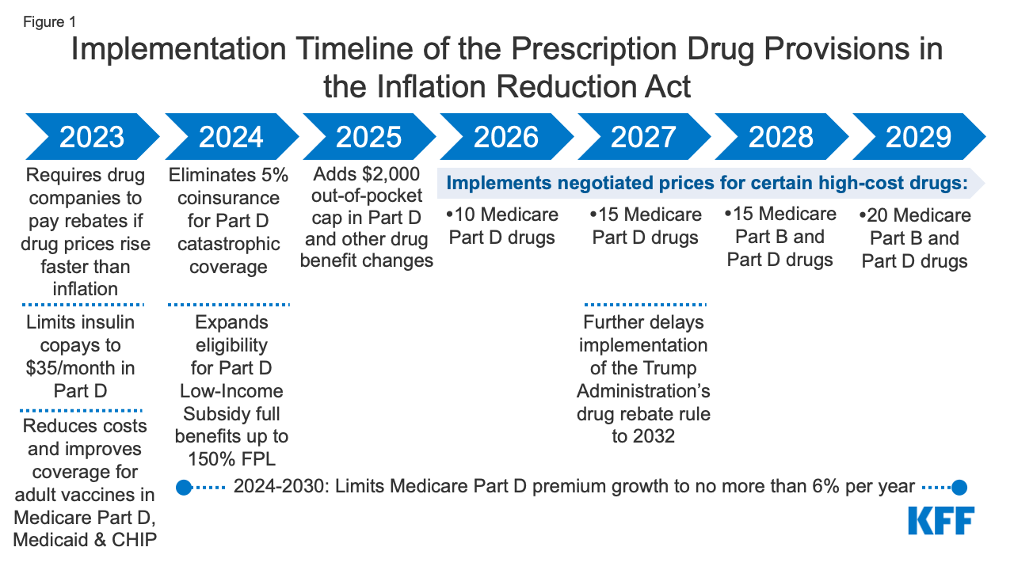
IRA Drug Pricing Provisions
Title, Text Layout
Target Drugs: Cimzia, Eylea, Keytruda, Opdivo, Prolia/Xgeva, Soliris, Entyvio, Sandostatin Lar Depot, Simponi / Aria, and Tyvaso / Orenitram ER

Slide 5
Next Steps and How This Plays Out
Title, Text Layout
CMS ramping up hiring to staff the “negotiation” arm
$3 billion allocated for 10 years
Lots of time and lots of things will happen before 2028
CMS has no experience “negotiating” drug prices
Steep learning curve
The wheels of government turn slowly
If Republicans take the House, they will drag CMS up to the Hill every chance possible
This will end up in the courts when at least one company will not “negotiate”
Possibly end up in the Supreme Court over constitutional issues
The outcome of the 2024 election for President will absolutely impact this if a Republican is elected
We have spent a lot of time with the White House and Congress trying to get providers out of the middle of “negotiations”
Good news is biosimilars are reimbursed at ASP + 8%!

Slide 6
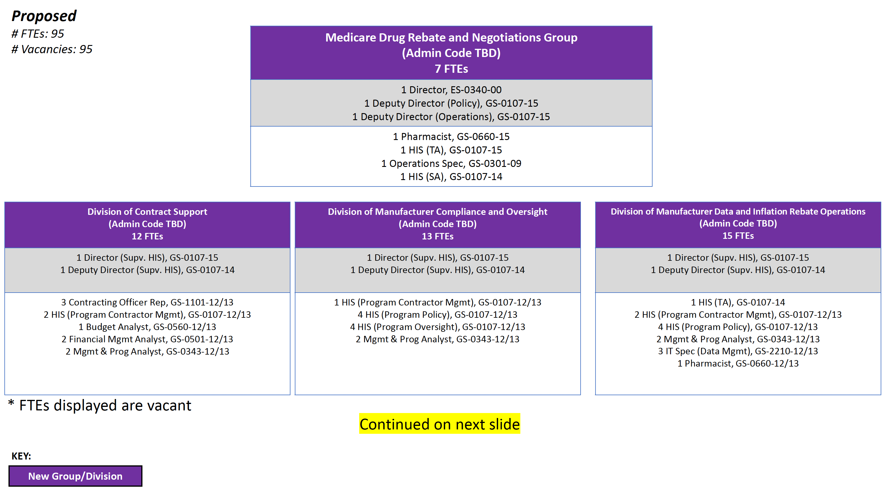
CMS “Negotiation” Structure
Title, Text Layout

Slide 7
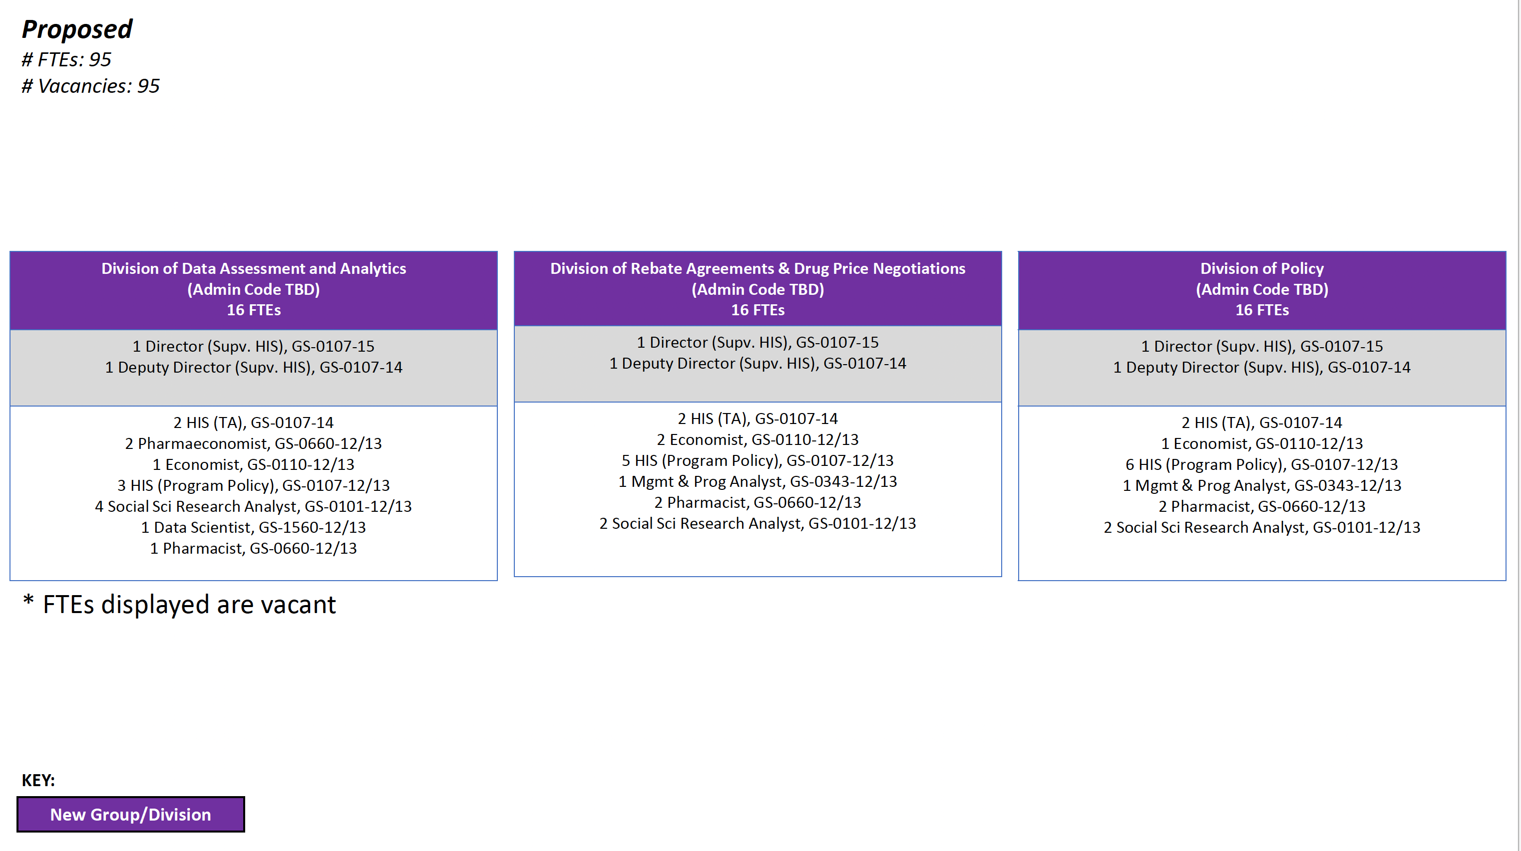
CMS “Negotiation” Structure (continued)
Title, Text Layout

Slide 8
What’s All Wrong with Medicare “Negotiating” Prices
Title, Text Layout
This is targeted at 60 million Medicare beneficiaries
Leaves 250 million Americans with commercial insurance or no insurance swinging in the wind
Launch prices will likely be increased
Pharma will protect products that may end up facing “negotiations” and from inflation caps
Won’t stop hospitals, especially large 340B hospitals, from marking up prices to patients with commercial insurance or no insurance
More Medicare reduces reimbursement on “negotiated” drugs, the more hospitals will charge commercial payers and patients
The courts may well kill this and weaken CMS
We are all over this in getting practices out of the middle of “negotiations”
Developed legislative language
Multiple calls with the White House and Congress
Possible “marker” bill introduced even this year

Slide 9
Background on the 340B Drug Pricing Program
Title, Text Layout
340B is a CRITICAL safety net program, especially for patients with cancer who are uninsured or underinsured
However, the program has expanded from a handful of safety net providers to 50+% of all U.S. hospitals (Source: Berkeley Research Group)
WAC list price value of 340B drug purchases reached $93.6 billion in 2021 (Source: IQVIA)
14% of the total U.S. pharmaceutical market
340B generated $40 billion in profits for participants (Source: Masia/Columbia University & SSR Health)
One estimate is that by 2026 340B will be the largest federal drug program, surpassing both Medicare and Medicaid drug programs (Source: Berkeley Research Group)

Slide 10
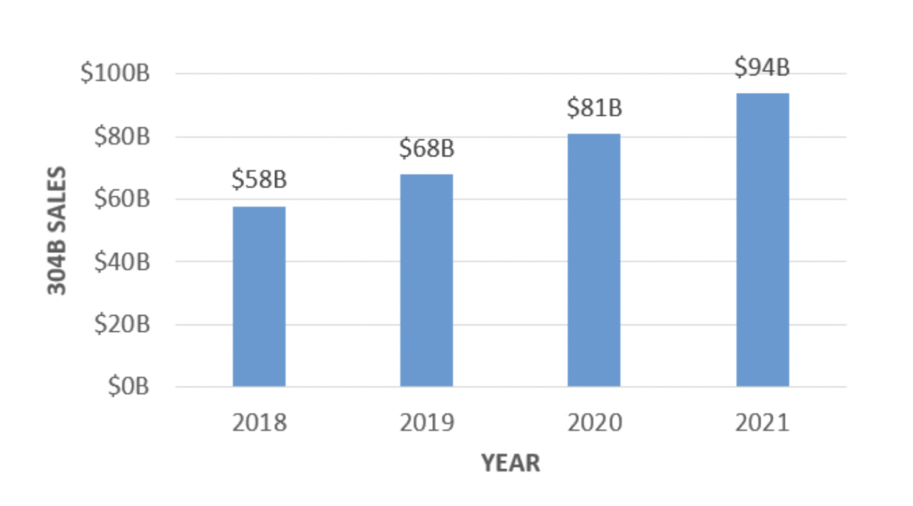
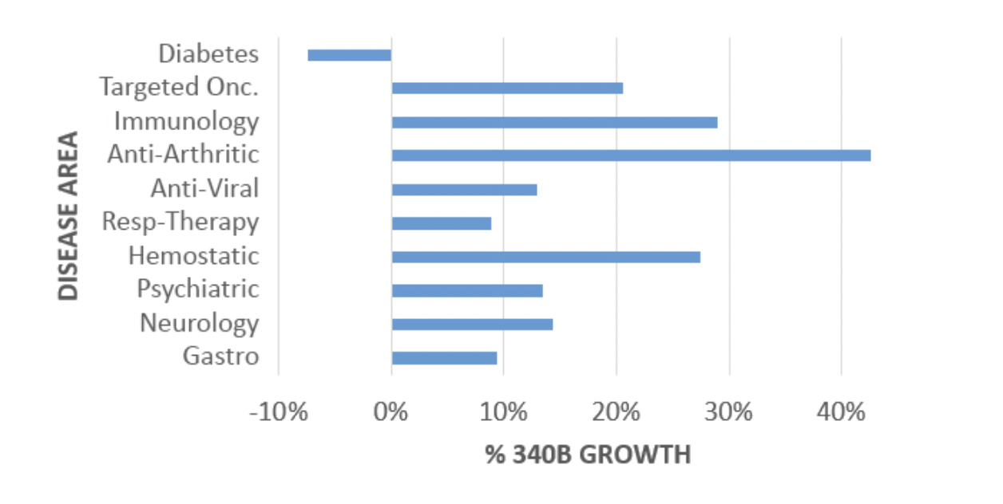
340B Growth Continues
Title, Text Layout
Source: https://www.iqvia.com/locations/united-states/blogs/2022/04/340b-program-continues-to-grow-while-contract-pharmacy-restrictions-take-effect

Slide 11
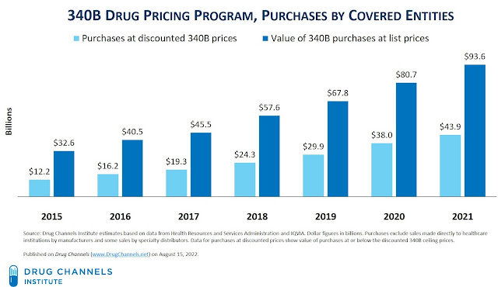
340B Growth Continues
Title, Text Layout

Slide 12
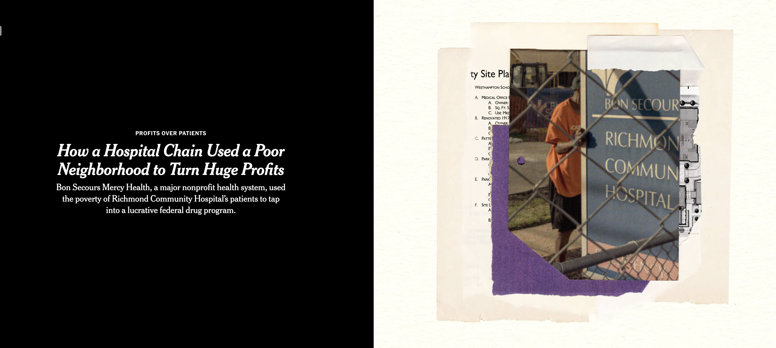
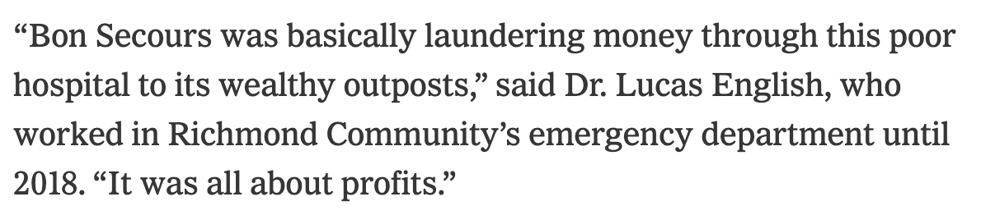
340B Hospitals in the Media Crosshairs
Title, Text Layout

Slide 13
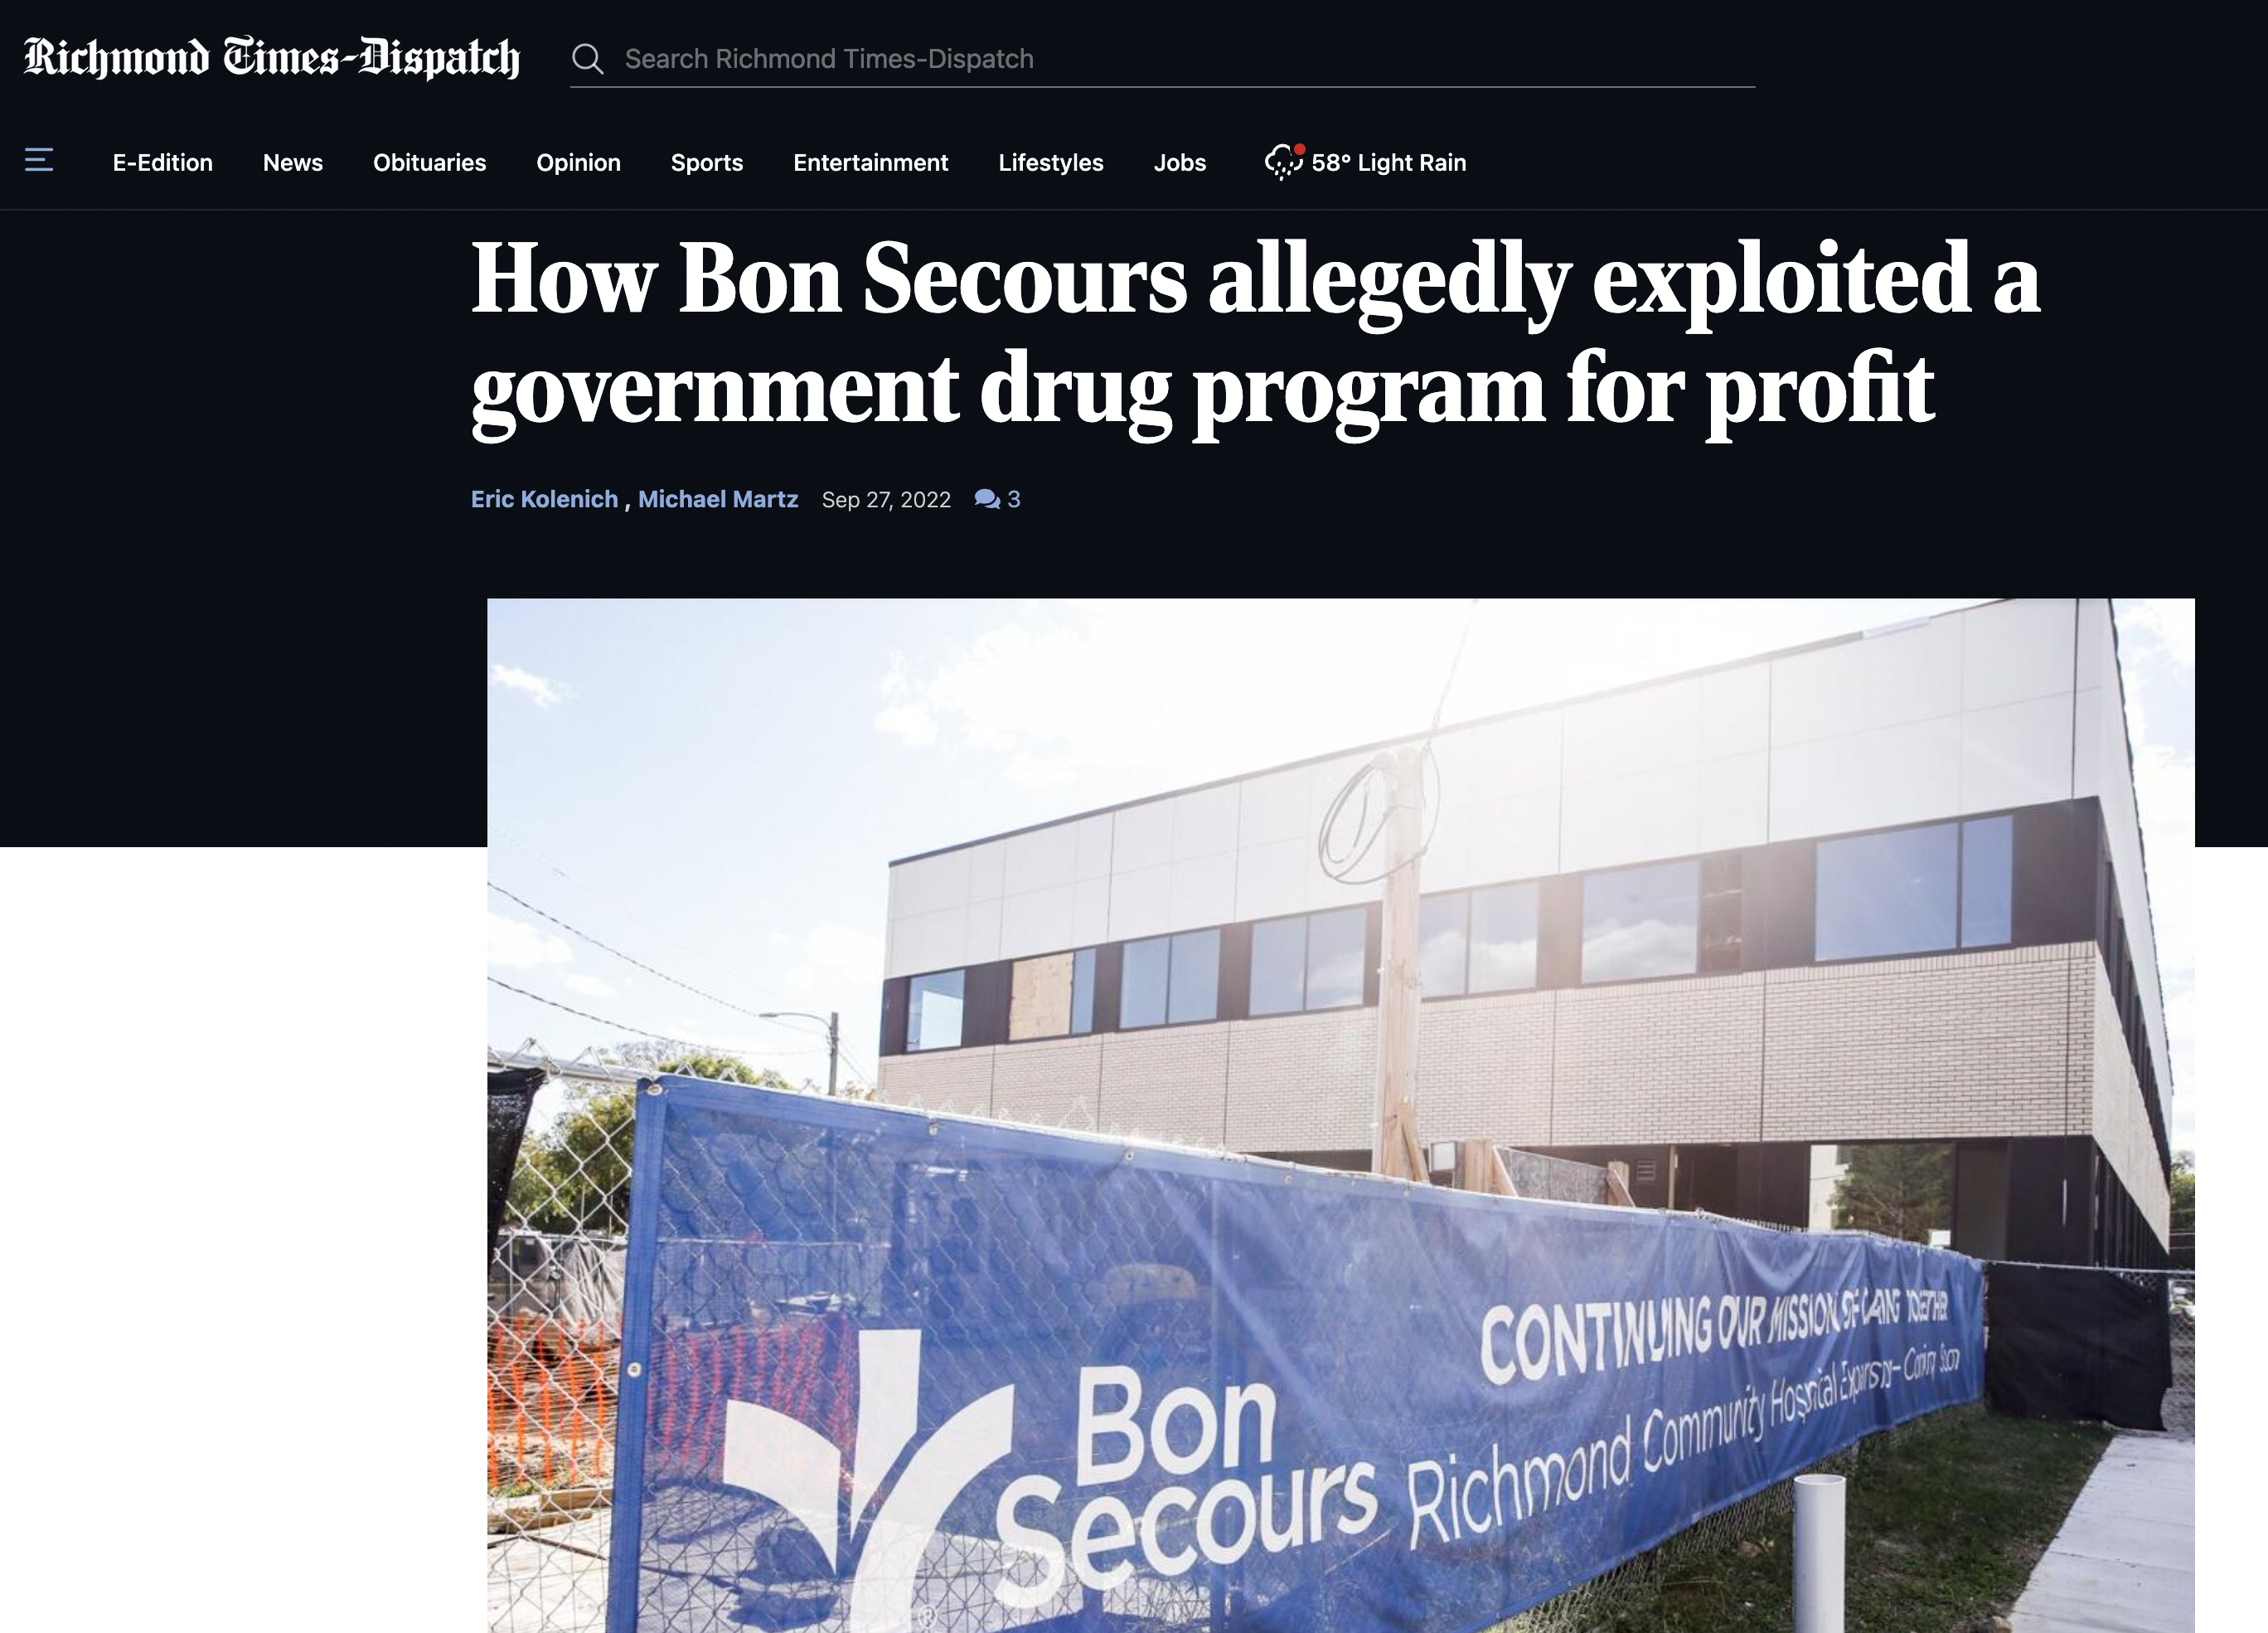
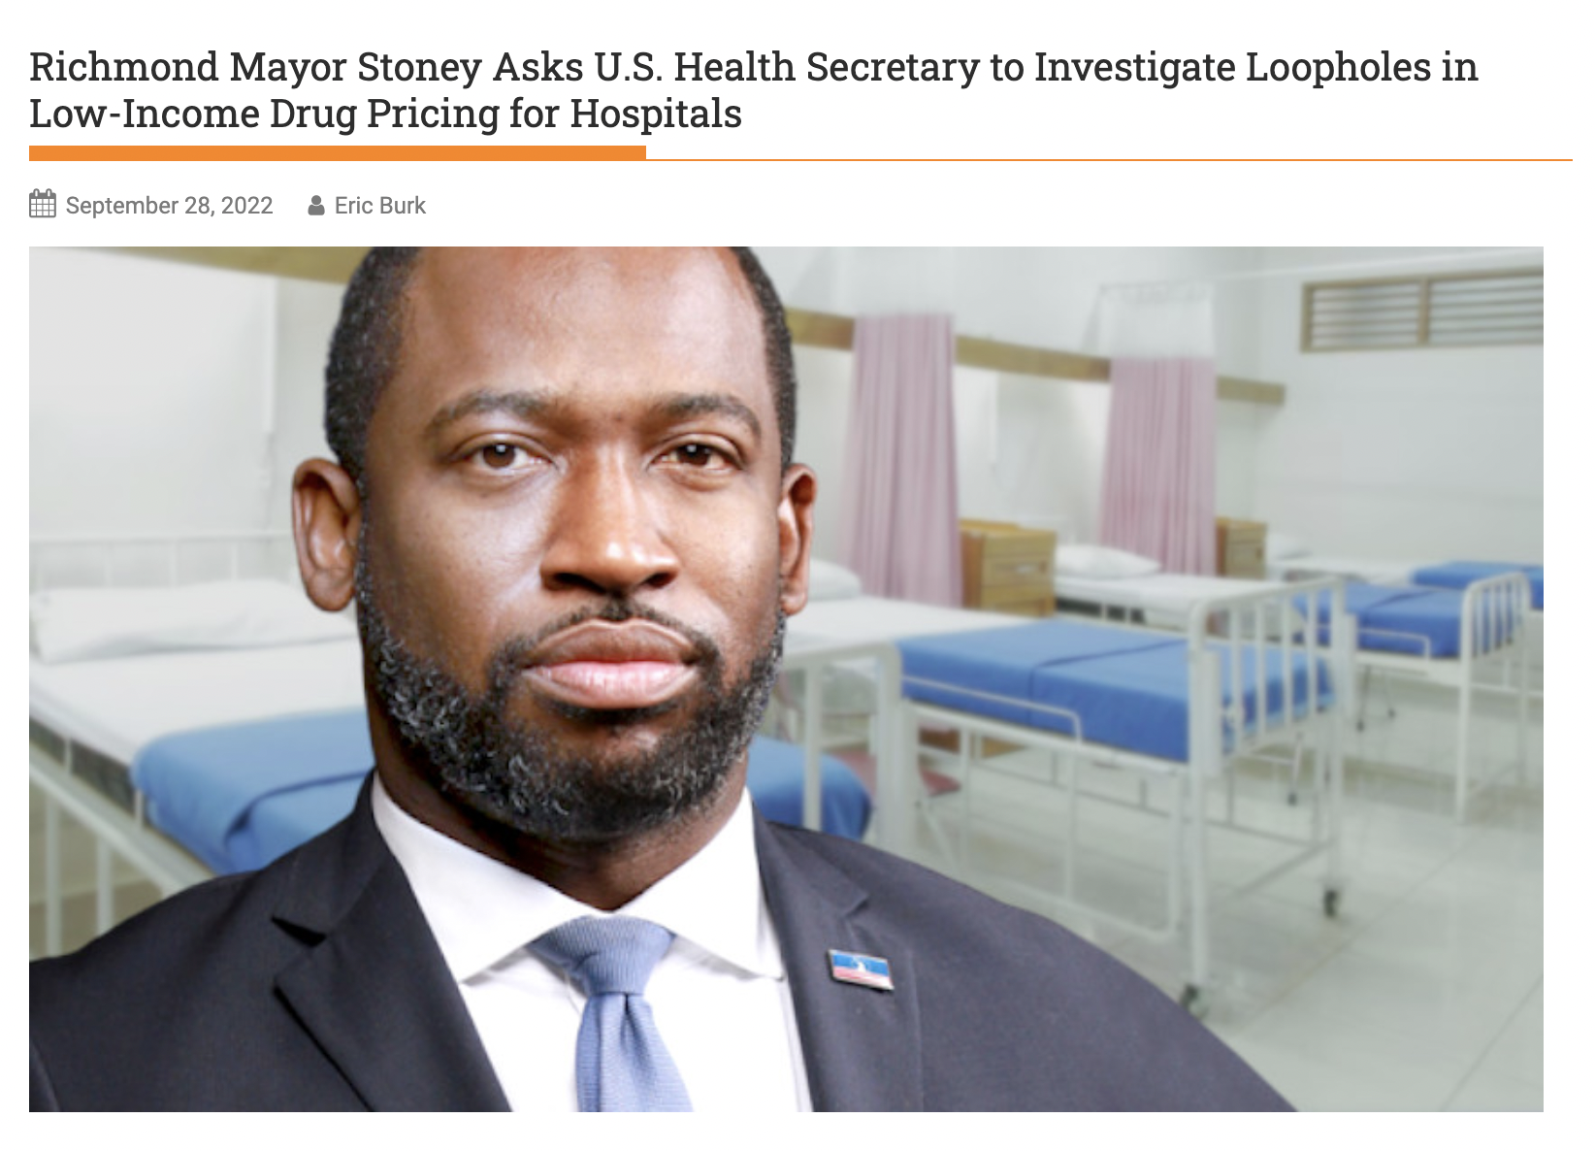
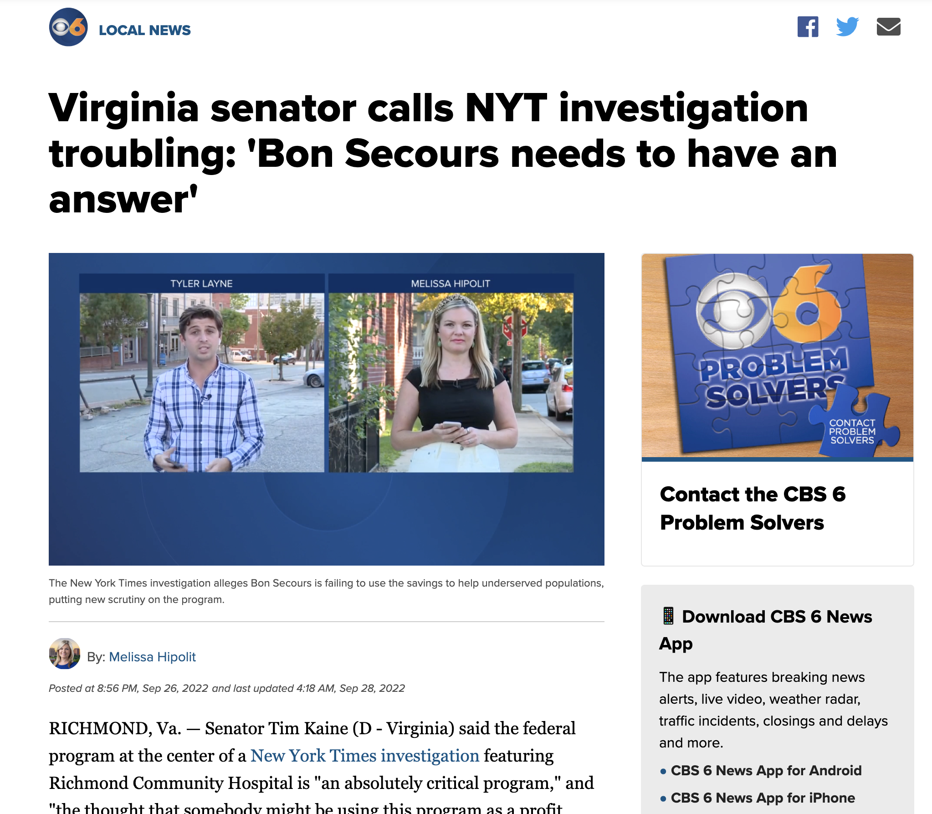
Creating a 340B Firestorm
Title, Text Layout

Slide 14
Impact of the Supreme Court Decision on 340B
Title, Text Layout
Very narrow decision basically saying HHS/CMS has to use hospital survey data to change 340B hospital Medicare reimbursement
Just pertains to 2018 & 2019
Litigation still pending for 2020, 2021 & 2022
CMS now has hospital survey data that would actually lower reimbursement from ASP – 22.5% to ASP – 28.7%
CMS released the proposed 2023 HOPPS rule stating likely to increase reimbursement to 340B hospitals by 37% (ASP + 6%)
D.C. Court recently ruled that CMS can’t wait till 2023 and must change reimbursement NOW
So, CMS is going to set the rate at ASP + 6% and try to figure out how to deal with budget neutrality
In short, this is a real mess!

Slide 15
What’s COA Doing?
Title, Text Layout
Published hospital drug mark-up study 2.0
Looks at top 340B hospitals’ reported data
Wrote 340B legislation that would ensure discounts go to patients in need, not to hospitals
In effect, the 340B discounts would ”follow the patient”
Would apply to 340B DSH hospitals and independent practices
Filed amicus briefs relating to both the Lilly and AZ versus HHS lawsuits over 340B restricting sales to 340B contract pharmacies
Working with the media
Looking at legal options to stop CMS from increasing reimbursement to 340B hospitals

Slide 16
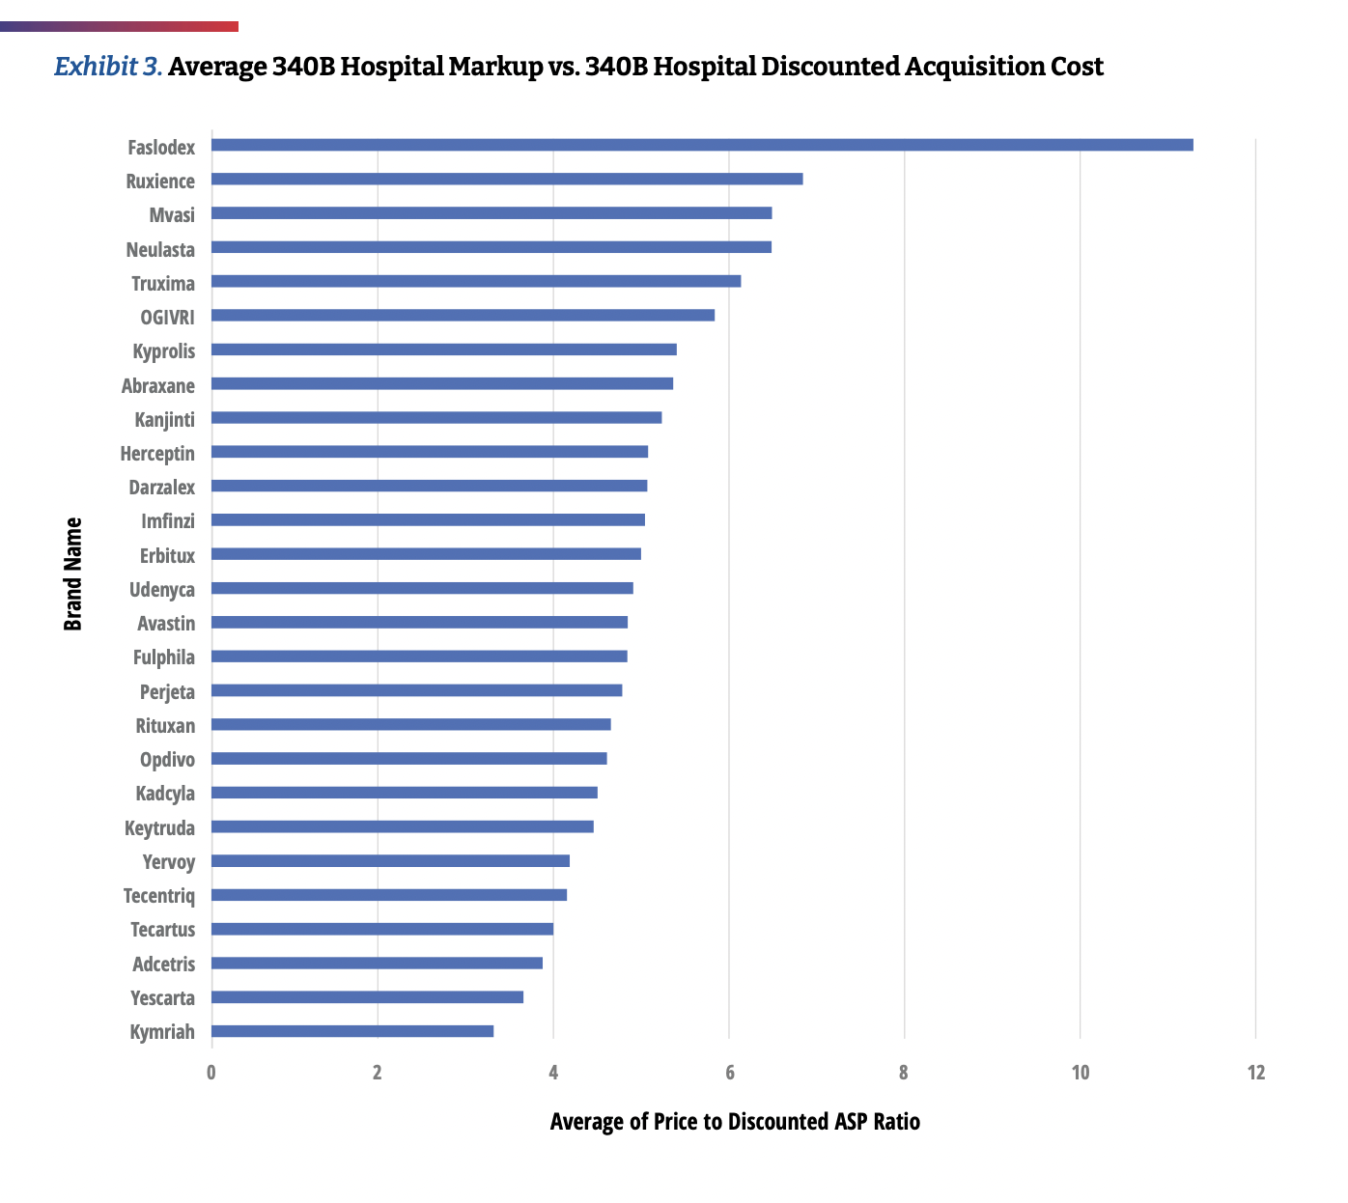
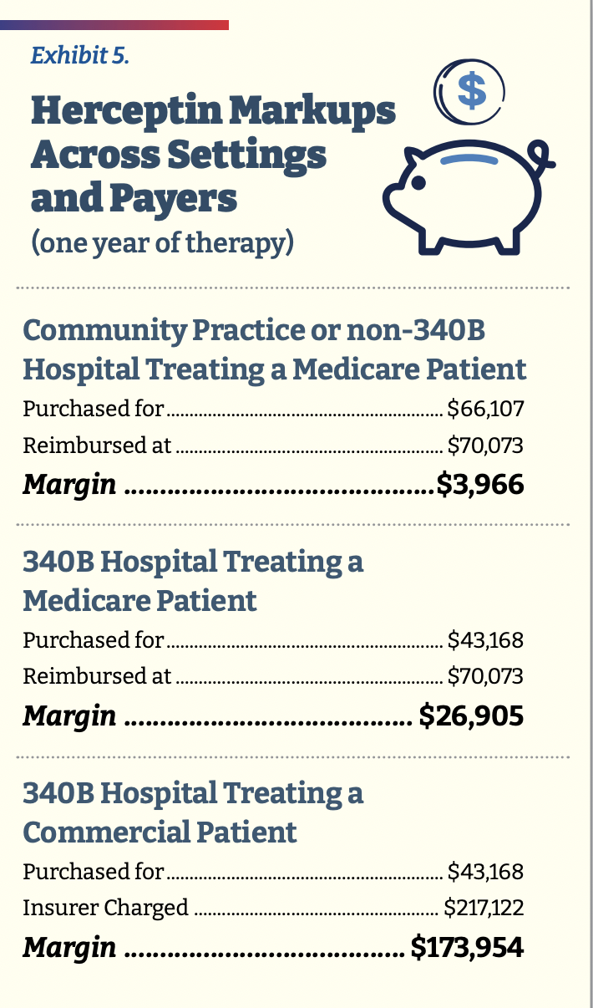
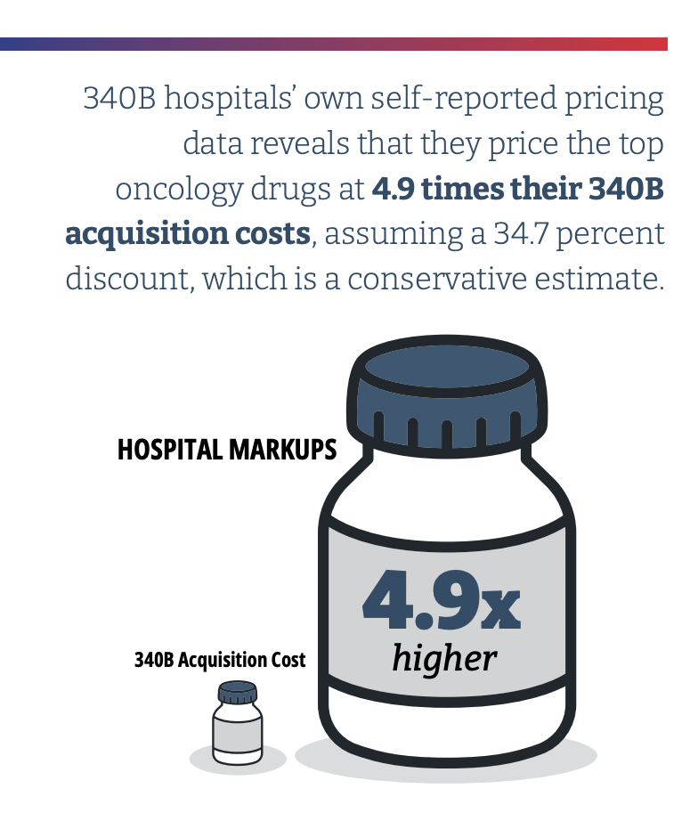
340B Hospital Drug Markups – COA Study 2.0
Title, Text Layout

Slide 17
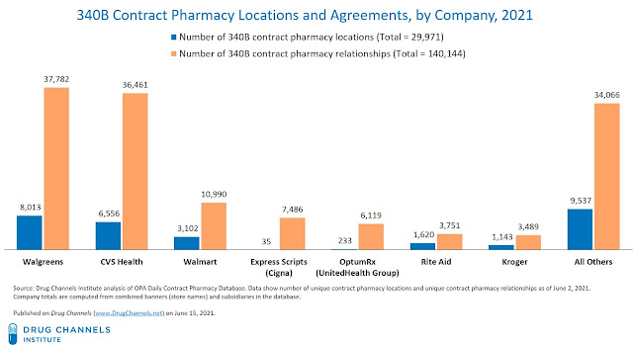
PBMs Now Major Players in 340B
Title, Text Layout
Top 3 PBM non-retail pharmacies now account for 18% of 340B pharmacy relationships (Source: Drug Channels)

Slide 18
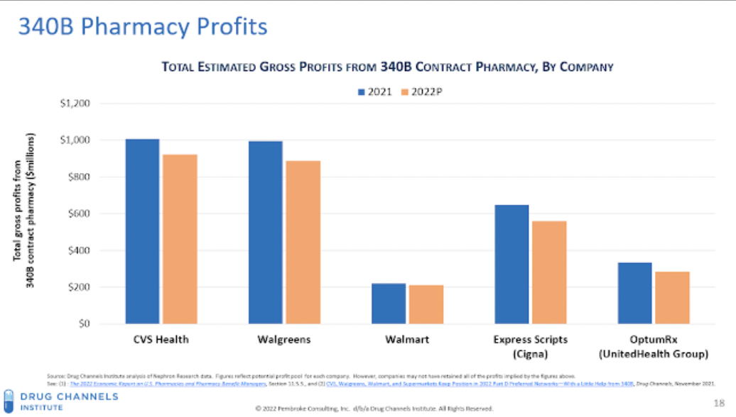
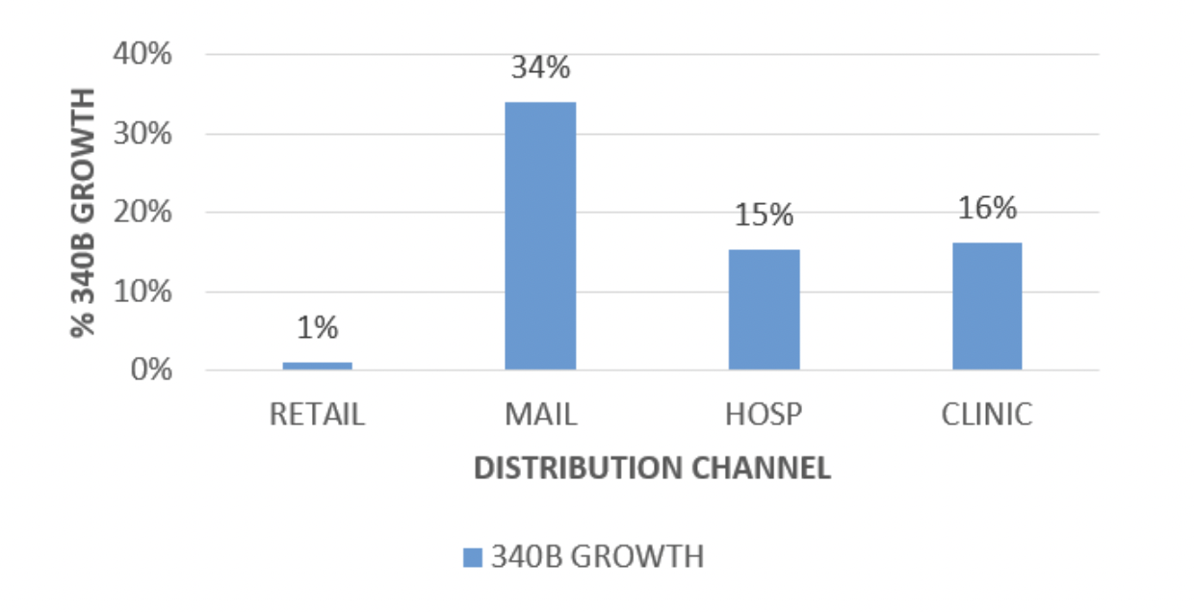
PBMs Making Huge Profits on 340B
Title, Text Layout
Source: https://www.iqvia.com/locations/united-states/blogs/2022/04/340b-program-continues-to-grow-while-contract-pharmacy-restrictions-take-effect

Slide 19
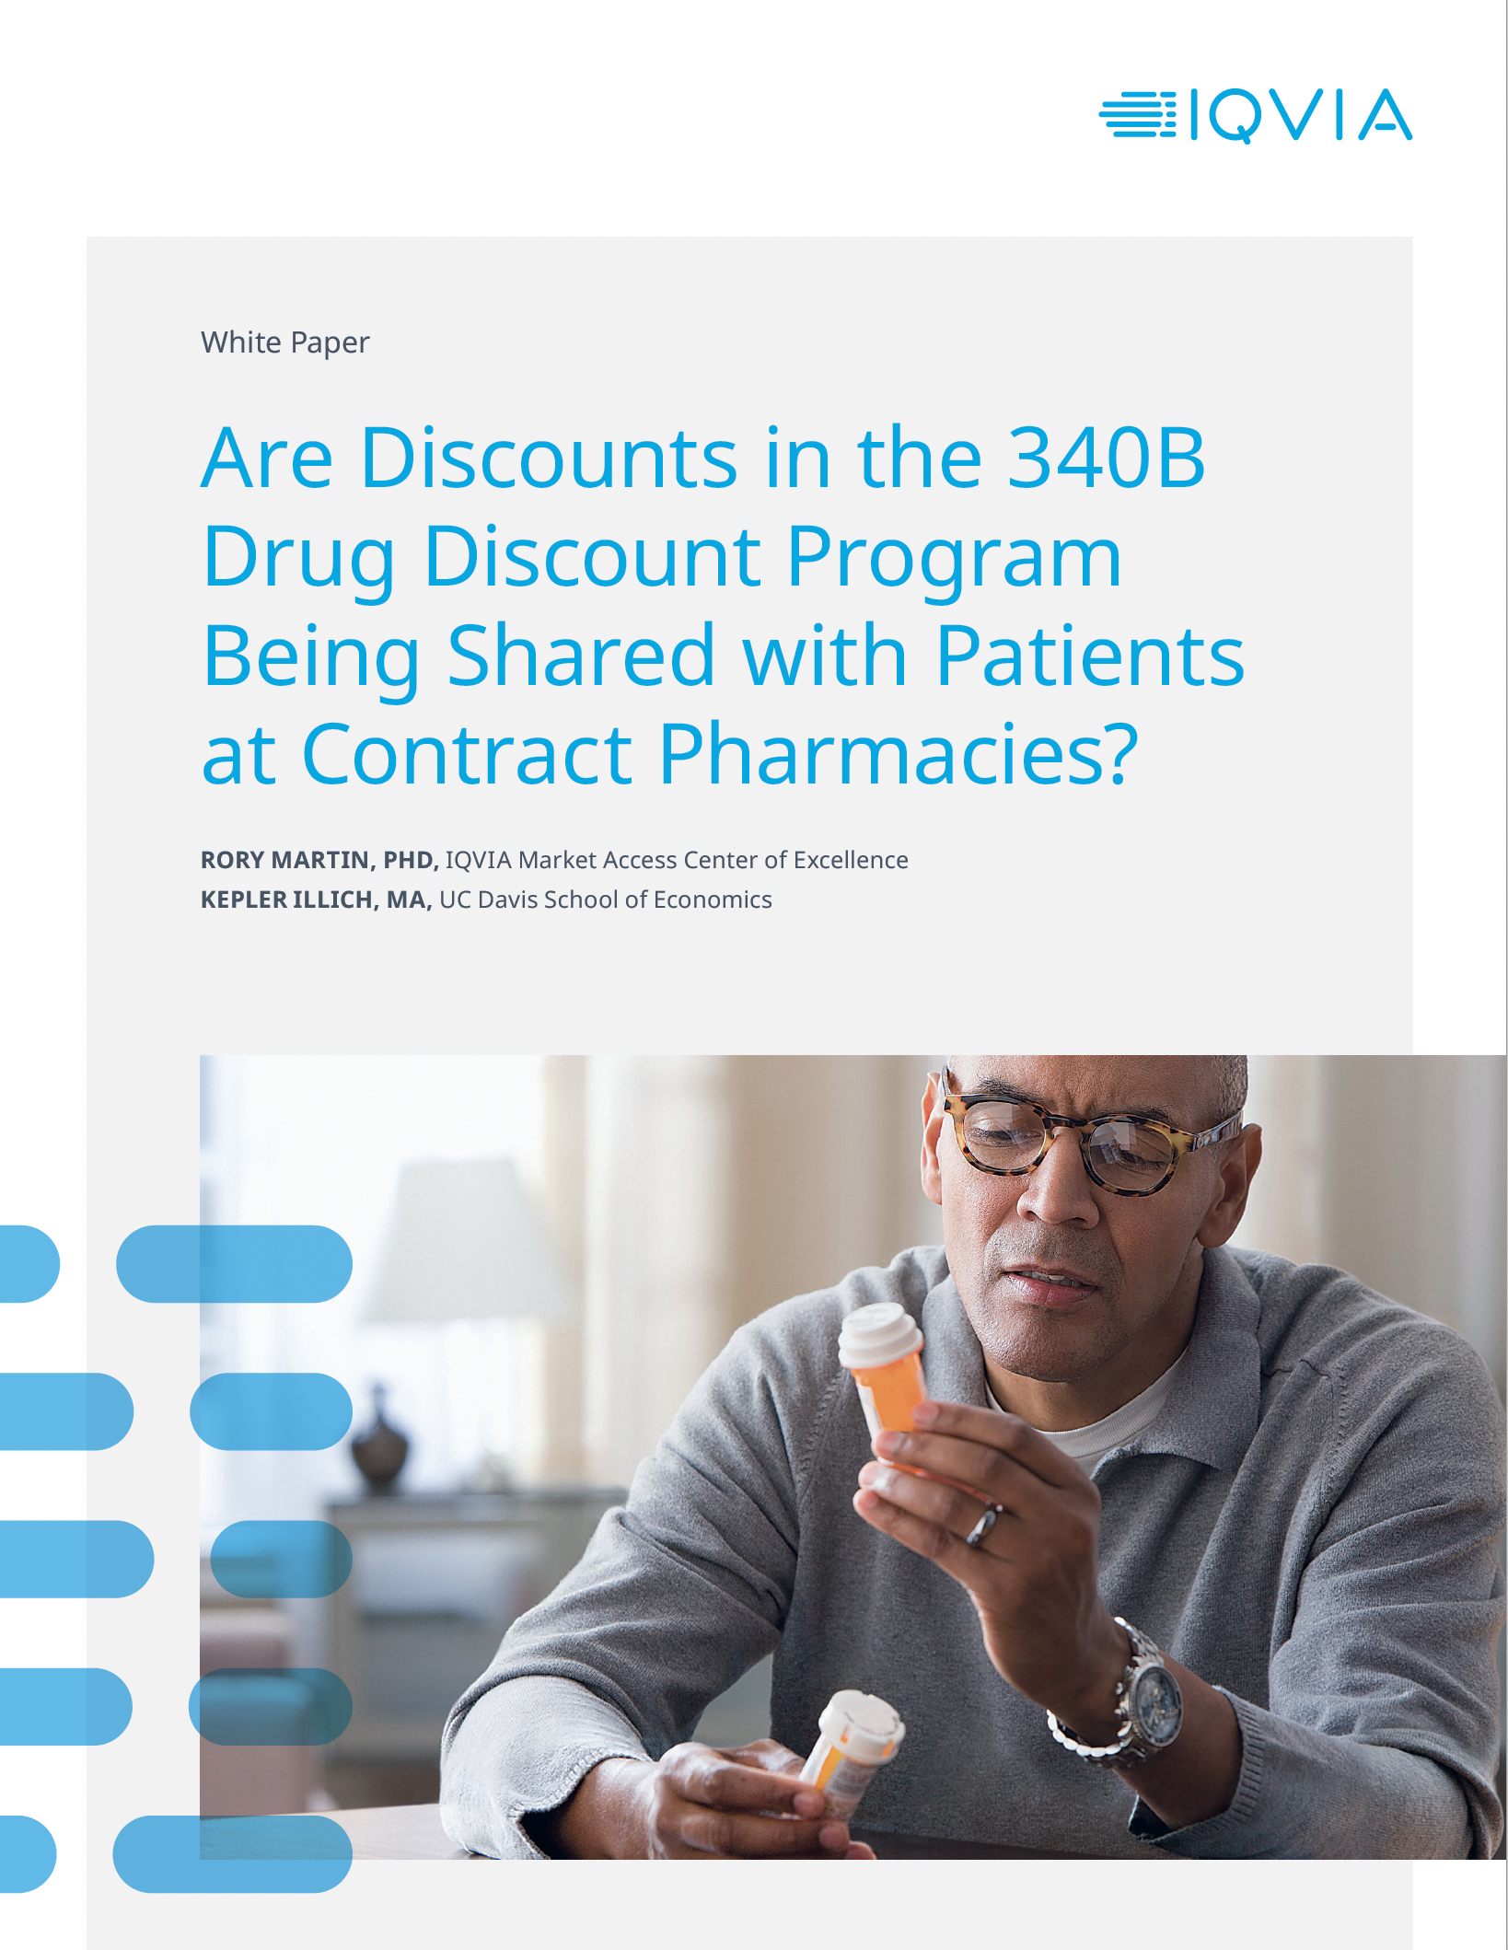
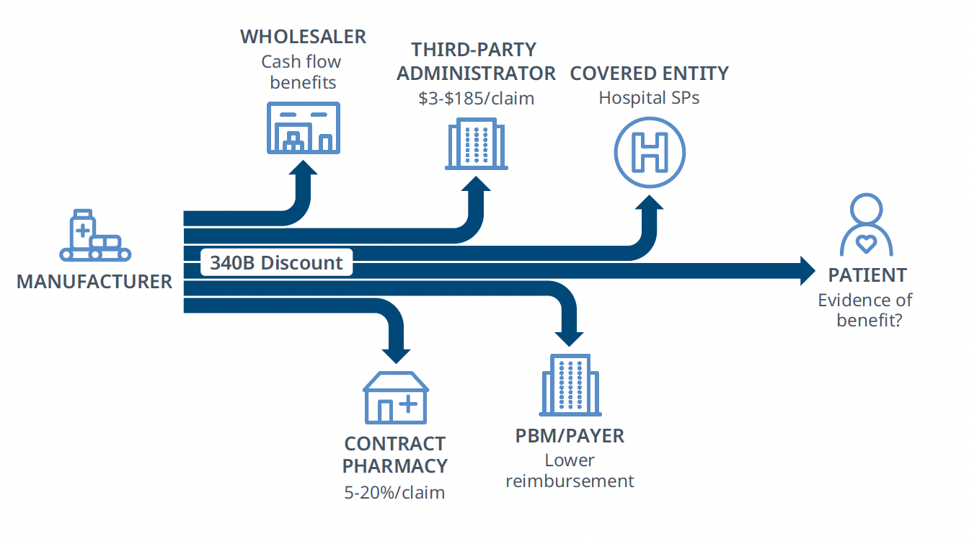
Are Patients Benefiting Directly from 340B?
Title, Text Layout
These findings demonstrate that 340B discount sharing at the point of sale at contract pharmacies is possible, but that most 340B-eligible patients at contract pharmacies are not directly benefiting from 340B discounts.

Slide 20
Implications of PBMs’ Intrusion in 340B
Title, Text Layout
Ask yourselves why insurers and their PBMs want to white bag injectables and fill orals from their specialty/mail order pharmacies?
Because they are 340B contract pharmacies!
And there is no oversight of contract pharmacies in terms of what they can and can’t do
Ultimately, the PBM/insurer complex wants to control what treatment is provided, who provides it and where!

Slide 21
What’s New on the PBM Front
Title, Text Layout
Pretty intense state activity and more to come when legislative sessions start back up in 2023
More federal activity as the Democrats have started to target PBMs
Senate Commerce Committee on PBMs
Senators Cantwell and Grassley’s bill on PBM transparency
Much more to come next year
More media coverage on PBM bad behaviors
Latest PBM-related issue is TRICARE letting Express Scripts do whatever it wants

Slide 22
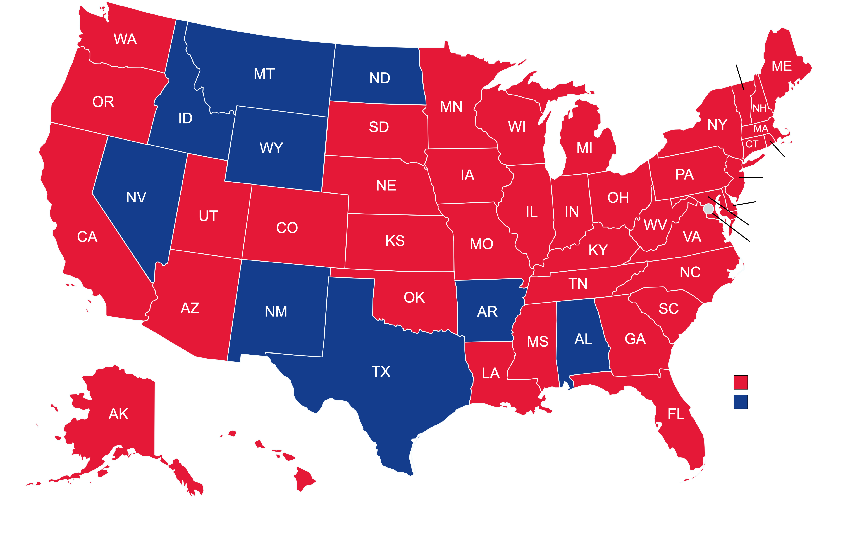
State Developments: 2022 By the Numbers
46 States in Session
In 2022, 41 states introduced bills of relevance to oncology and pharmacy benefit managers.
350+ Industry Bills
300+ bills were introduced with the intention of reforming pharmacy benefit manager practices, while an additional 50+ concerned additional topics of relevance to oncology.
61 Bills Passed
17% of all bills filed were passed in 2022. Total passed is reflective of consolidation, not rate of success.
VT
RI
NJ
DE
MD
DC
COA Engaged (‘22)
Not in session or
Priority legislation
Not introduced
Map last updated 04/25/22

Slide 23




2022 State Developments: Top Performers
Massachusetts
29 Bills Filed
Issues:
PBM Transparency
Anti-steerage
Maximum Allowable Cost
Rebate Passthrough
Accumulator Adjustment Programs
New Jersey
28 Bills Filed
Issues:
PBM Licensure
PBM Transparency
Prior Authorization
Step Therapy
Accumulator Adjustment Programs
Oklahoma
23 Bills Filed
Issues:
PBM Licensure
PBM Transparency
Step Therapy
Prior Authorization
Maximum Allowable Cost Lists
Minnesota
20 Bills Filed
Issues:
PBM Licensure
PBM Transparency
Anti-steerage
Maximum Allowable Cost
Rebate Passthrough

Slide 24



2022 Trending State Reforms
PBM Licensure
Licensure bills require pharmacy benefit managers to apply for a license to operate in a state. Licensure bills may require a PBM to follow specific requirements and guidelines in order to obtain a license and may institute fees and penalties for PBMs. Licensure bills may also establish revolving funds to continue oversight.
PBM Transparency
Transparency bills vary widely. Some require pharmacy benefit managers to report to a state agency or other regulatory body on an annual or biannual basis, disclosing information concerning rebates, formulary changes, pharmacy ownership information, and contract information. Other bills prohibit PBMs from imposing gag clauses on pharmacists.
Accumulator Adjustment Program Bans
AAP bills require PBMs to recognize copay assistance programs, waivers, and third-party payments for prescriptions as part of a patient’s deductible and annual out-of-pocket costs.

Slide 25
Enhancing Oncology Model Purpose & Timeline
“The purpose of the new EOM is to drive transformation in oncology care by preserving or enhancing the quality of care furnished to beneficiaries undergoing treatment for cancer while reducing program spending under Medicare fee-for-service (FFS).”
“Under EOM, participants will be incentivized to consider the whole patient and engage with them proactively, during and between appointments.”
Application period closed October 10, 2022
Non-binding application
CMS reviewing each application and acceptance notification late 2022 or early 2023
Model starts on July 1, 2023, and runs for five years until June 30, 2028

Slide 26
Enhancing Oncology Model Overview
Builds off of the Oncology Care Model (OCM)
Like the OCM, the Enhancing Oncology Model (EOM) is a voluntary model
Like the OCM, the EOM has two methods of payment
Per beneficiary, per month Monthly Enhanced Oncology Services (MEOS) payment
Reward payment for saving Medicare money based on performance (Performance-Based Payment or PBP)
But significant differences from the OCM
Open to Physician Group Practices (PGPs) only
Must have at least one oncologist
Can participate in other CMMI models (e.g., Maryland Total Cost of Care Model)
Only 7 cancer types
Focused on addressing health inequities in cancer treatment
Requires practices to do more but be paid less
Screen for health-related social needs
Implement ePROs
Requires practices to assume risk from the start
Two options of less risk and more risk
“cancer-type specific approach to calculating benchmarks”

Slide 27
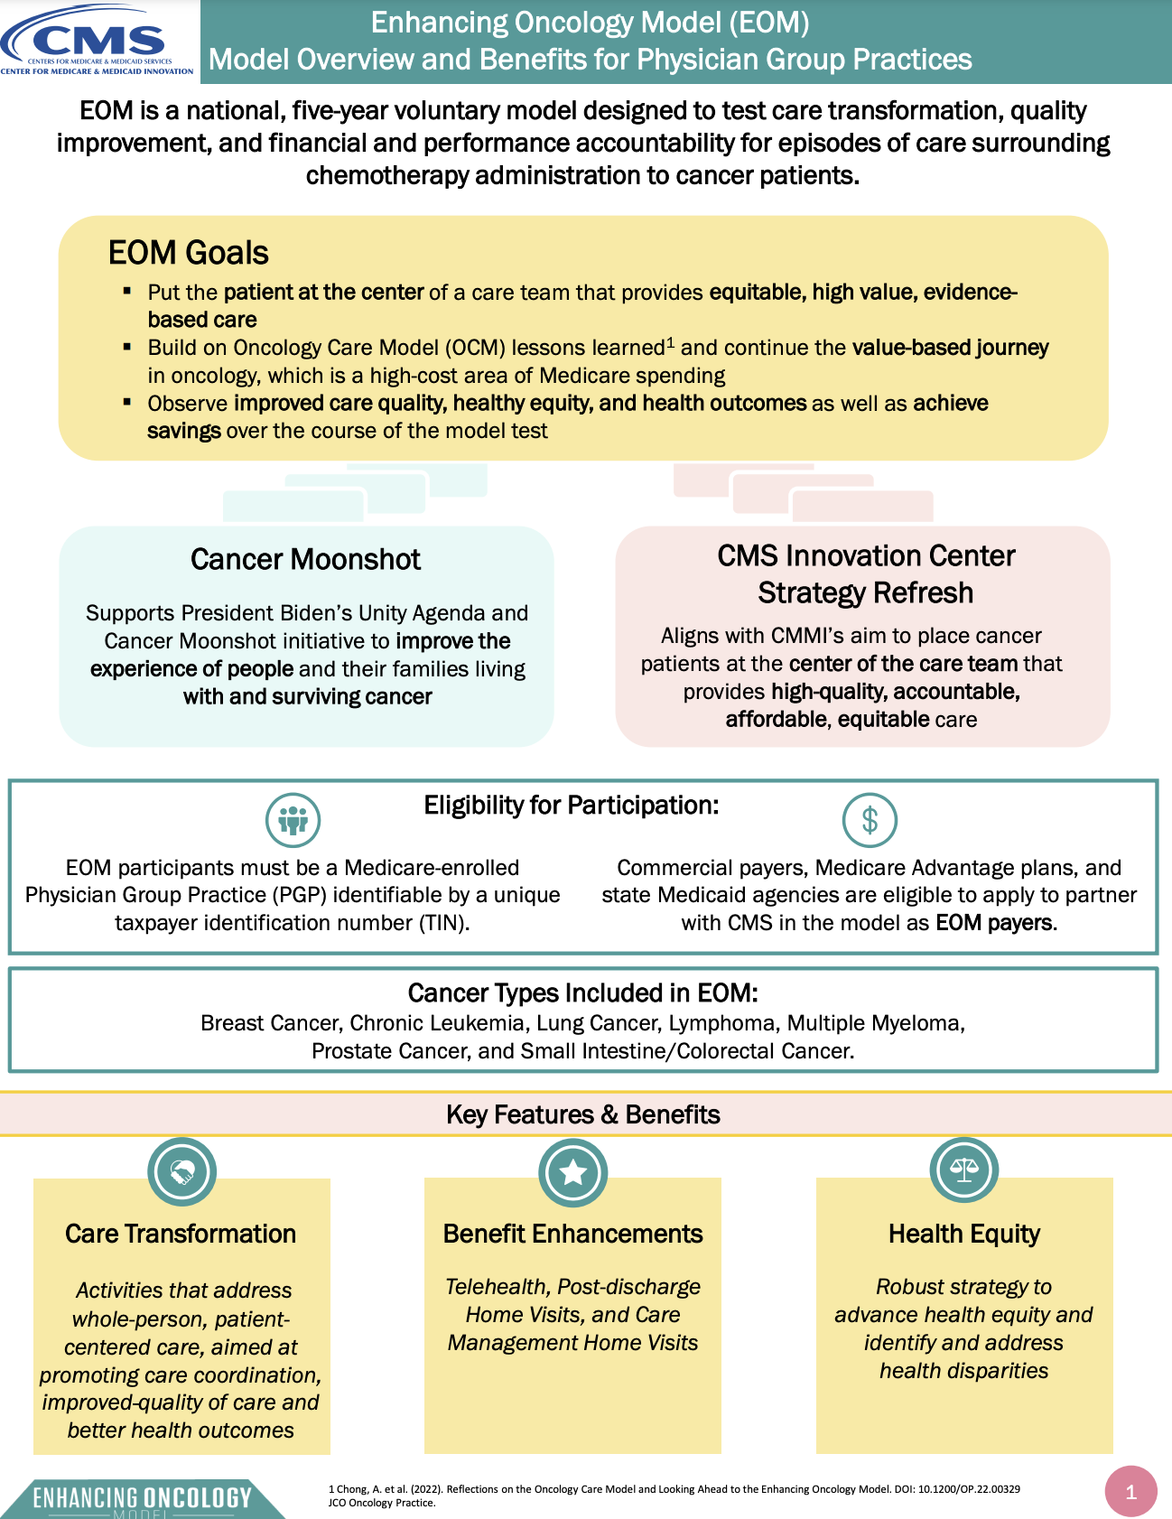
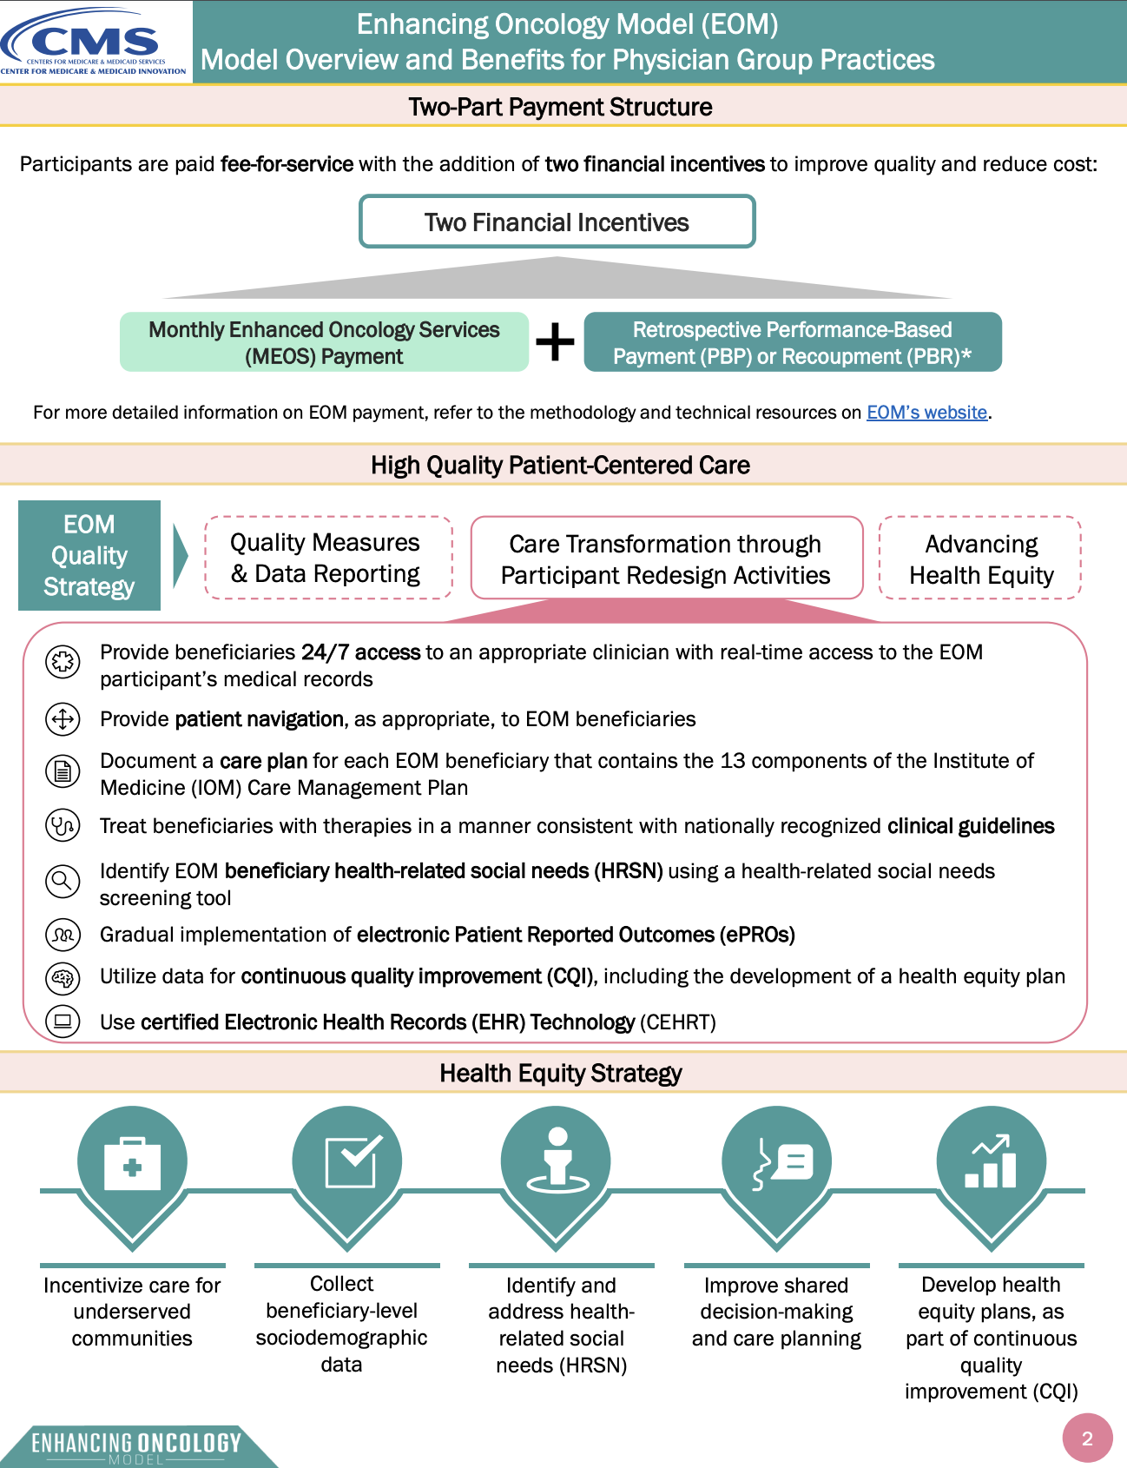
CMS Enhancing Oncology Model Summary

Slide 28
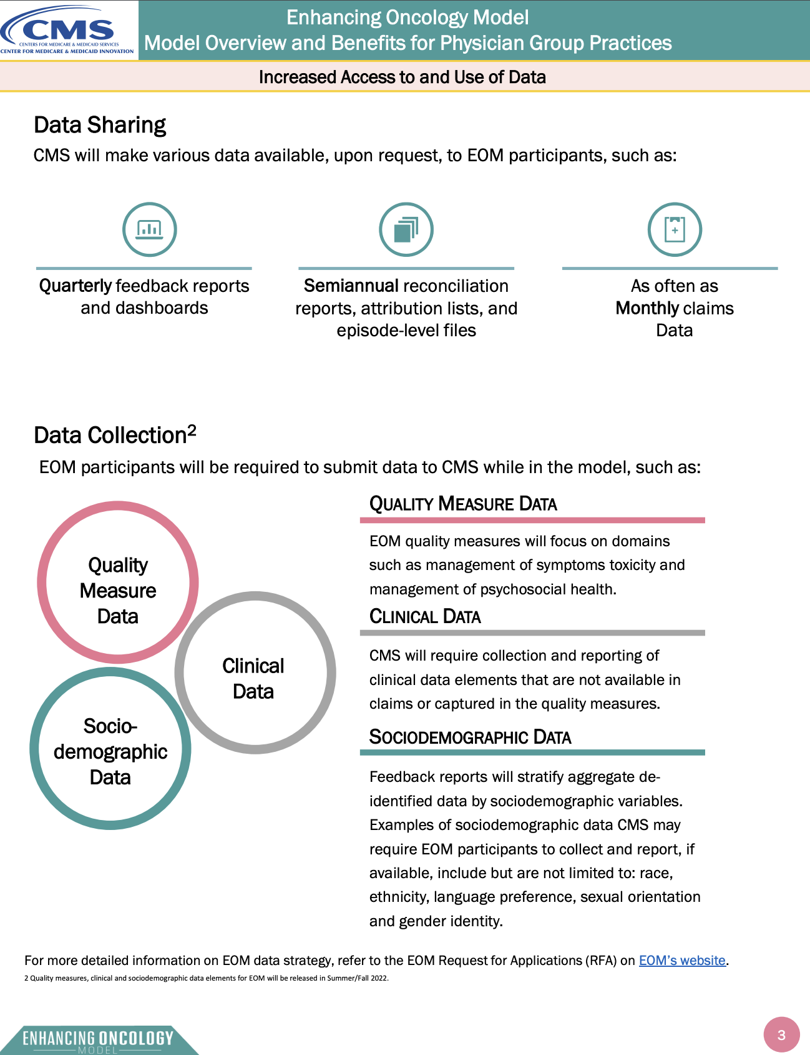
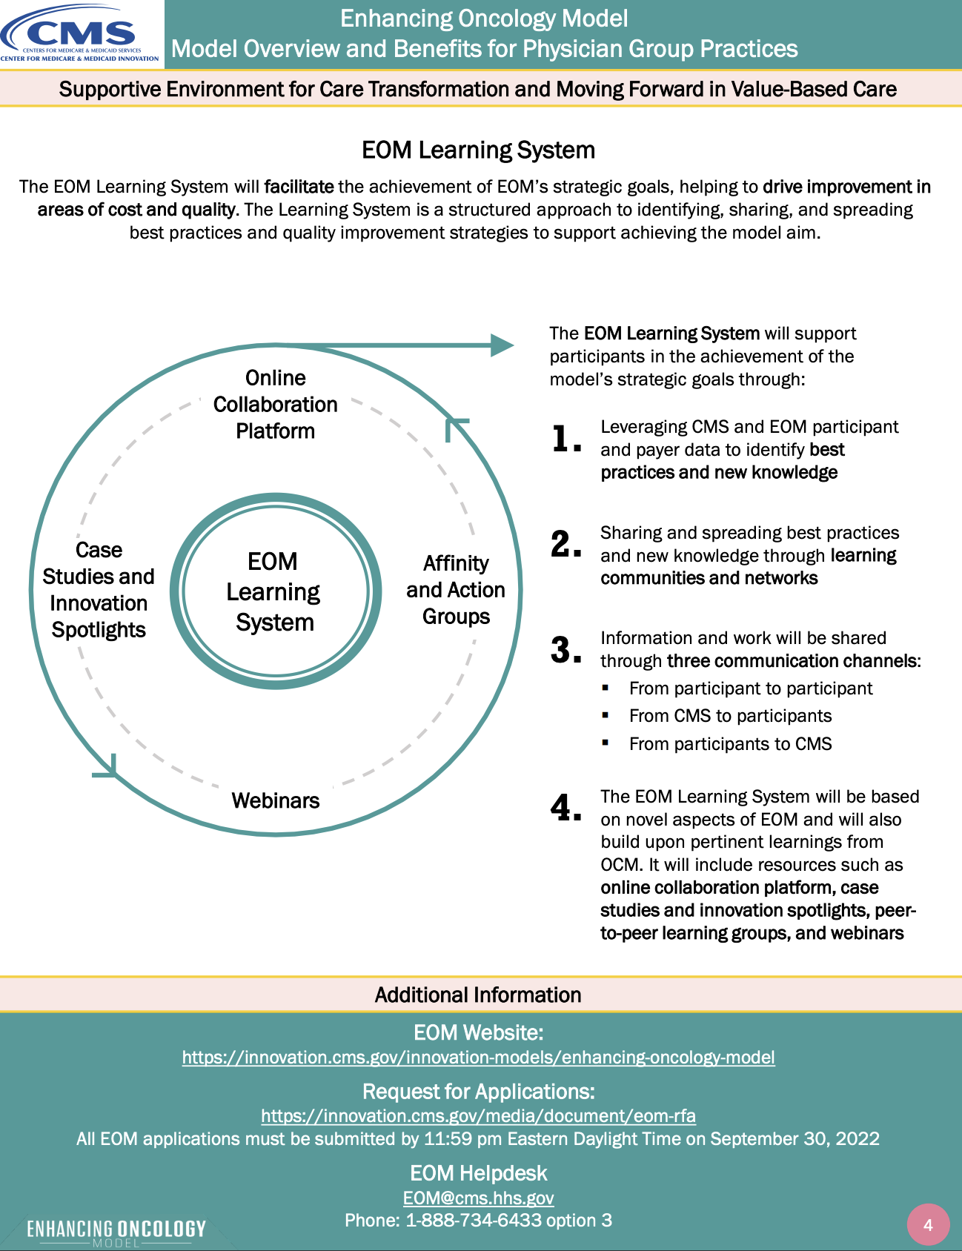
CMS Enhancing Oncology Model Summary

Slide 29
Comparison of the OCM vs. EOM
Provision | Oncology Care Model | Enhancing Oncology Model
Medicare Beneficiary Population | Medicare beneficiaries with a cancer diagnosis who are receiving chemotherapy (including hormonal therapies) | Medicare beneficiaries with one of seven cancer types: breast, lung, lymphoma, multiple myeloma, small intestine/colorectal, prostate, and chronic leukemia receiving systemic chemotherapy (not including exclusively hormonal therapies)
Required Practice Redesign Activities | Six cross-cutting requirements providing for broad improvements in cancer care, including documenting a care plan that includes the 13 elements of the Institute of Medicine (IOM) Care Management Plan | Same as OCM with addition of two practice redesign activities: gradual implementation of electronic Patient Reported Outcomes (ePROs) and screening for “health-related social needs” (HRSNs) using an HRSN tool.
Data Sharing & Collection | No collection of sociodemographic data. CMS did not stratify data based on sociodemographic factors within feedback reports or reconciliation reports | Sociodemographic data required, if available, as a part of EOM health equity focus. CMS may share with EOM participants certain aggregated, de-identified data; for example, aggregate utilization data, stratified by sociodemographic metrics (e.g., dual status, LIS eligibility, and race and ethnicity).

Slide 30
Six Practice Redesign Activities + Two EOM Additions
Provide beneficiaries 24/7 access to an appropriate clinician with real-time access to the EOM participant’s medical records.
Provide patient navigation, as appropriate, to EOM beneficiaries.
Document a care plan for each EOM beneficiary that contains the 13 components of the IOM Care Management Plan, as applicable to the EOM beneficiary.
Treat beneficiaries with therapies in a manner consistent with nationally recognized clinical guidelines.
Utilize data for continuous quality improvement (CQI).
Use Certified EHR Technology (CEHRT) as specified in 42 CFR § 414.1415(a).
Identify EOM beneficiary health-related social needs using a HRSN tool.
Gradual implementation of electronic Patient Reported Outcomes (ePROs).

Slide 31
Comparison of the OCM vs. EOM (continued)
Provision | Oncology Care Model | Enhancing Oncology Model
Per Beneficiary/Per Month (PBPM) Payment | Monthly Enhanced Oncology Services (MEOS) payment amount of $160 PBPM for each OCM beneficiary. The entire $160 is included as episode expenditures | MEOS payment amount of $70 PBPM but increased to $100 PBPM for dual-eligible beneficiaries dually of which $70 will be included as episode expenditures in reconciliation calculation
Drug Payment | No change from Medicare fee-for-service of ASP + 6% (ASP + 4.3% with sequester). Total cost of care responsibility that includes Part B drug payment and certain Part D expenditures | Same as the OCM
Attribution Methodology for MEOS and Performance-Based Payment | E&M claims with a cancer diagnosis on the service line during a six-month episode | Attribute to the eligible oncology provider with the first qualifying E&M service after initiating chemotherapy, provided that the provider has at least 25% of the cancer-related E&M services during the episode. If the initiating oncology provider does not bill at least 25% of cancer-related E&M services during the episode, then attribute based on plurality of cancer-related E&M services at an oncology PGP.

Slide 32
Comparison of the OCM vs. EOM (continued)
Provision | Oncology Care Model | Enhancing Oncology Model
Novel Therapies Adjustment for Performance-Based Payment | Calculated in aggregate across all cancer types | Calculated separately for each of the seven included cancer types
Risk Adjustment for Performance-Based Payment | All cancer types included in one price prediction model. Clinical data used in final five performance periods, where participating practice-reported metastatic status is included in risk adjustment | Included cancer type-specific price prediction models. A more robust use of EOM participant reported clinical and staging data in risk adjustment, to include metastatic status and HER2 status
Risk Arrangements for Performance-Based Payment | One-sided risk in performance period (PP) 1, followed by the option for one-sided or two-sided risk in PP2 to PP7. Participants earning a performance-based payment by the initial reconciliation of PP4 have the option to stay in one-sided risk from PP8 to PP11. Other participants must either accept two-sided risk in PP8 to PP11 or be terminated from the model. | Two mandatory downside risk arrangement options. Option 1 is less aggressive two-sided risk with minimal downside risk. Option 2 is more aggressive two-sided risk.

Slide 33
Comparison of the OCM vs. EOM (continued)
Provision | Oncology Care Model | Enhancing Oncology Model
Risk Arrangements for Performance-Based Payment (continued) | Original Risk Arrangement Discount: 2.7% of benchmark amount Stop-gain/stop-loss: 20% of benchmark amount Alternative Risk Arrangement Discount: 2.5% of benchmark amount Minimum threshold for recoupment: 2.5% of benchmark amount Stop-gain: 16% of total Part B revenue for the practice Stop-loss: 8% of total Part B revenue for the practice. | Risk Arrangement 1 (RA1) EOM discount: 4% of the benchmark amount Target amount: 96% of the benchmark amount Downside risk (stop-loss): 2% of the benchmark amount Upside risk (stop-gain): 4% of the benchmark amount Risk Arrangement 2 (RA2) EOM discount: 3% of the benchmark amount Target amount: 97% of the benchmark amount Downside risk (stop-loss): 6% of the benchmark amount Upside risk (stop-gain): 12% of the benchmark amount

Slide 34
EOM Problems: What COA is Doing
Like the OCM, the EOM is too prescriptive
Government telling physicians how to practice
Worse yet, telling them they are not practicing correctly
Requires practices to do more but will pay almost half as much in the OCM
Puts more onus on oncologists
Prohibits billing for Chronic Care Management Services
CMS doesn’t understand the use of ePROs
Immediately mandating 2-sided risk
Nearly impossible to qualify as an Alternative Payment Model (APM) because of the limitation to only 7 cancer types
Will mean MIPS reporting
Benchmarks are not available until after the model starts
No indication that CMS has the ability to provide timely, understandable feedback

Slide 35
Briefed Congress on the Oncology Model Debacle
Briefed Republicans on the Energy & Commerce Committee on the oncology model “debacle”
First oncology model was the COME HOME model
CMMI spent $19 million on a successful model
Model was over and put to rest
Next up was the OCM
While the OCM was going on CMMI tried three times to launch national models to end-run Congress on drug pricing reform
Fall of 2019, CMMI released a concept paper on the Oncology First Model
Never heard another thing about it
OCM was extended a year due to COVID
EOM released in June 2022
OCM ended at the end of June 2022
So, one year gap between the OCM end and the EOM start

Slide 36
COA’s Current Focus & Top Priorities
Title, Text Layout
Pushing Congress to stop Medicare physician payment cuts
PBMs, PBMs, PBMs
Working on the TRICARE issue as an immediate priority
DIR fees, DIR fees, DIR fees
Worked with Congress to hold a hearing/forum on PBMs
Talking to Congress about the next hearing/forum in 2023
Ongoing communications with CMS and the FTC
Submitted written comments to the FTC in May
Working on new legislation to stop sham DIR “quality” programs
Stopping “fail first” step therapy edits
Iron therapy most recent example with UnitedHealth Care
Major push to curb/stop prior authorizations
Working on “gold card” legislation
Stop white bagging initiatives
White bagging ”legal” letter for practices
Working with payers, where possible

Slide 37
Focus & Priorities (continued)
Title, Text Layout
PBMs, PBMs, PBMs (continued)
Steering to PBM-affiliated pharmacies & delaying patients’ oral drugs
“72-hour” bill
Congressional action
Major PBM whitepaper/exposé released by Frier Levitt for COA
340B reform
Discount “follows the patient” – wherever the patient is treated – to benefit patients in need, not hospital systems
Working closely with major media
Exploring legal options to stop CMS from increasing drug reimbursement to 340B hospitals
Working with CMMI to make changes in the EOM
Ramping up initiatives on health disparities

Slide 38
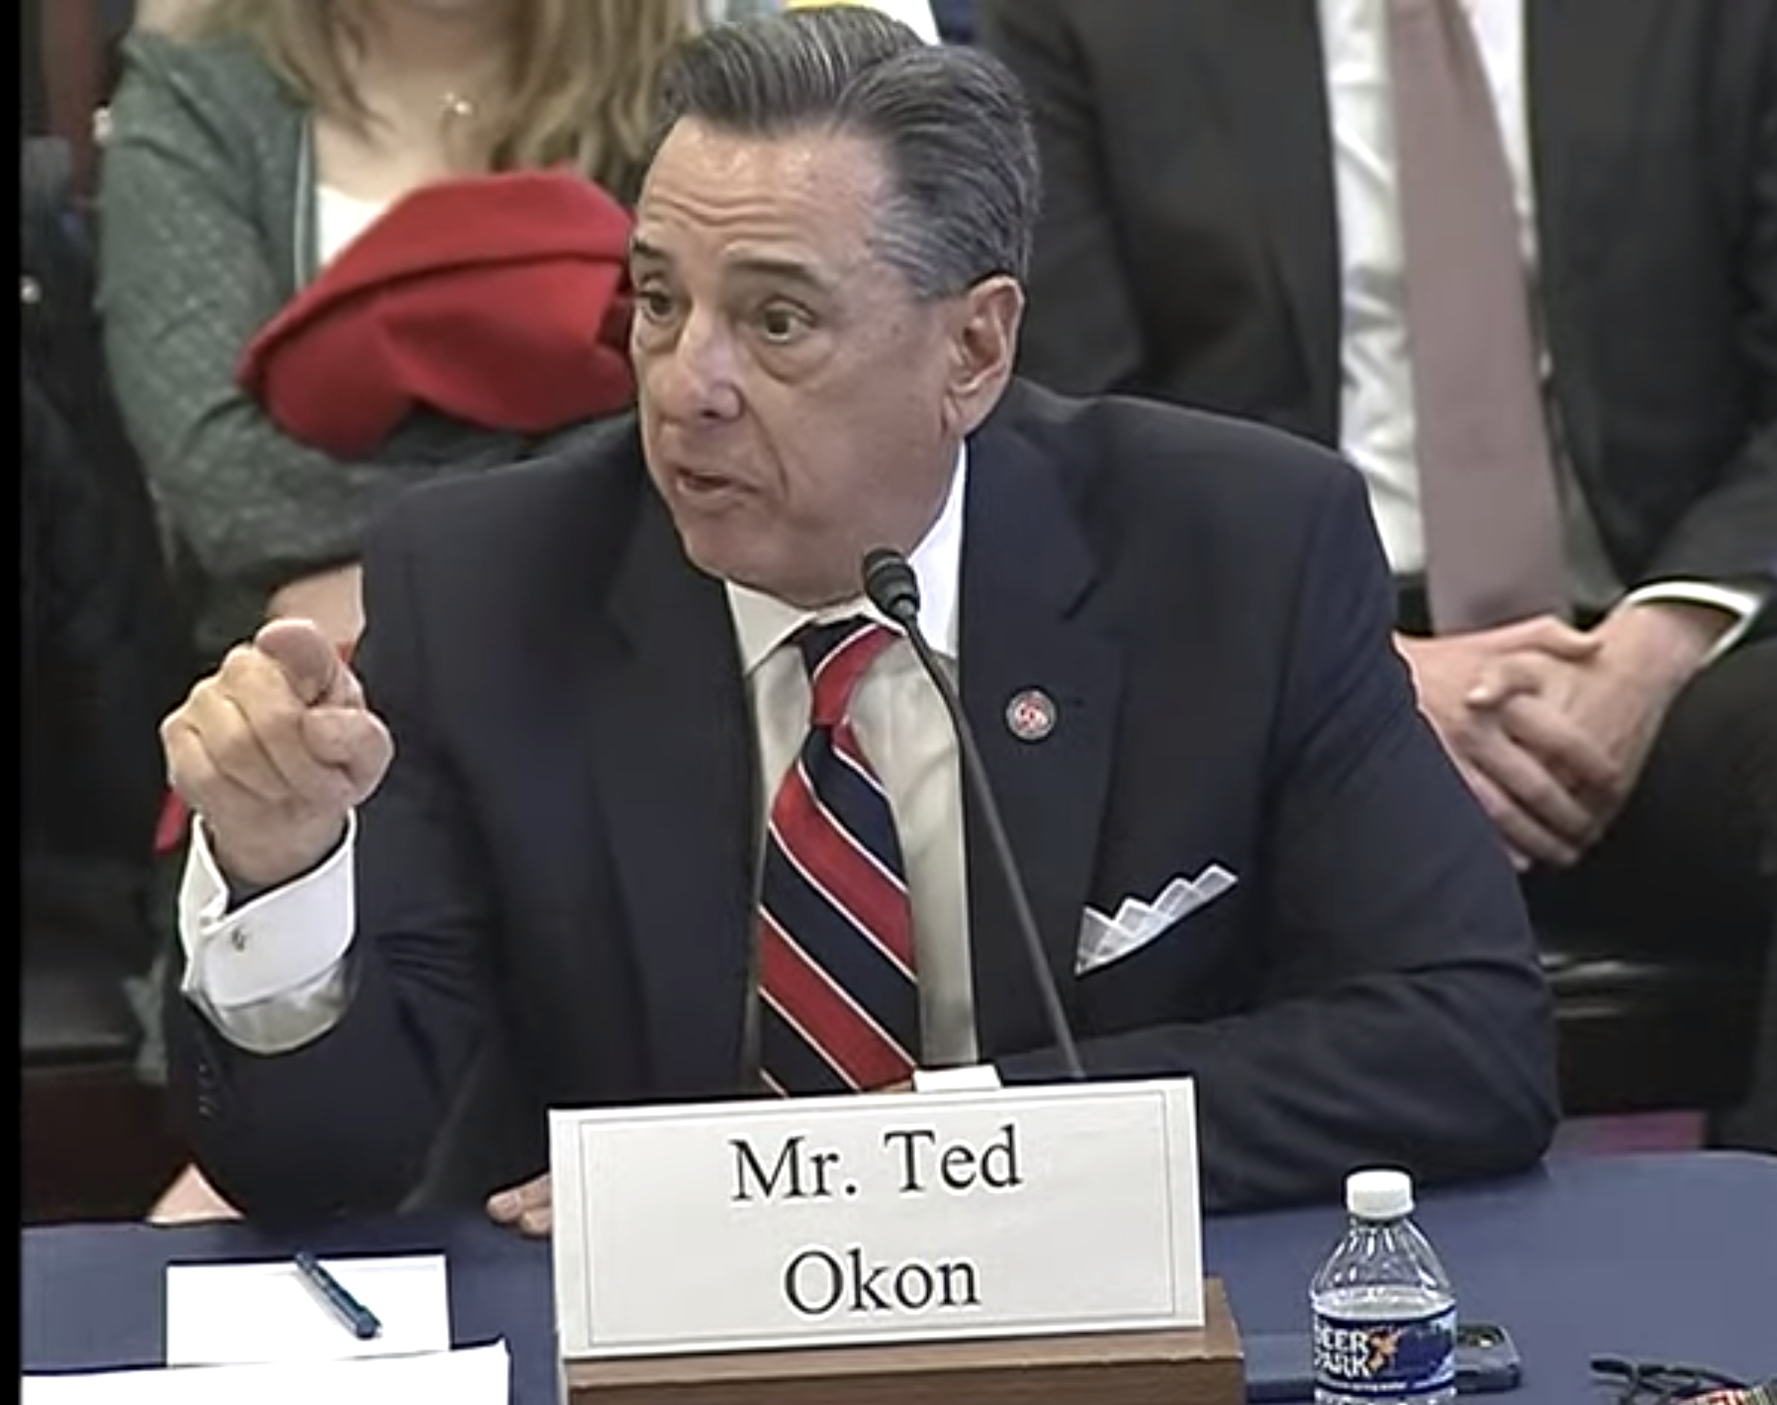
Thanks!
Title, Text Layout
Ted Okon
Email: tokon@COAcancer.org
Web: www.CommunityOncology.org
Twitter: @TedOkonCOA

